Slide 1
Preservation of Paper
Storage, Materials, Environment, and Conservation

Slide 2
Overview
Agents of Deterioration
Preservation vs Conservation
Environment
Incoming Collections
Housing Collections
Flattening and Humidification
Digitization

Slide 3
Agents of Deterioration
Why do my documents look like that?

Slide 4
Why Does Paper Deteriorate?
In the 17th and 18th century papermakers used rags and linen to make paper
In the 19th century wood pulp was introduced into paper making
Wood pulp is acidic by nature, it has lignin which is what causes the brown or yellow discoloration in paper
Chemicals, such as chlorine bleach are added to make the paper white
Over time the chemicals in the paper “off gas” and become more acidic
Acid can be transferred from item to item, not just limited to paper

Slide 5
Paper Deterioration Continued
Environmental factors can contribute to the deterioration of paper as well
Humidity is a major factor in the deterioration of documents. Paper absorbs water quickly and can promote the growth of mold and attract bugs.
Humidity can also contribute to the brittleness of paper
Fluctuating temperatures can also promote the growth of mold and attract bugs.
Light will cause documents to fade and can cause the paper to become brittle.
Air quality, depending on what is in the environment can cause paper to have an odor, break down the fibers, or fade the ink or pencil on the document

Slide 6
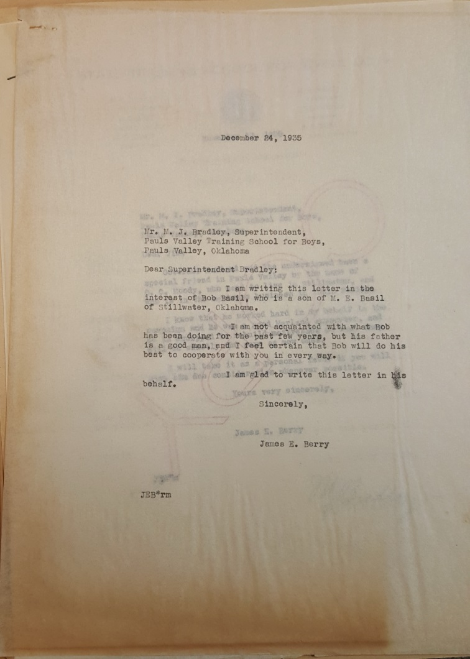
Example of Acid Migration
You can see here how the acid from the folder has migrated and stained the page.

Slide 7
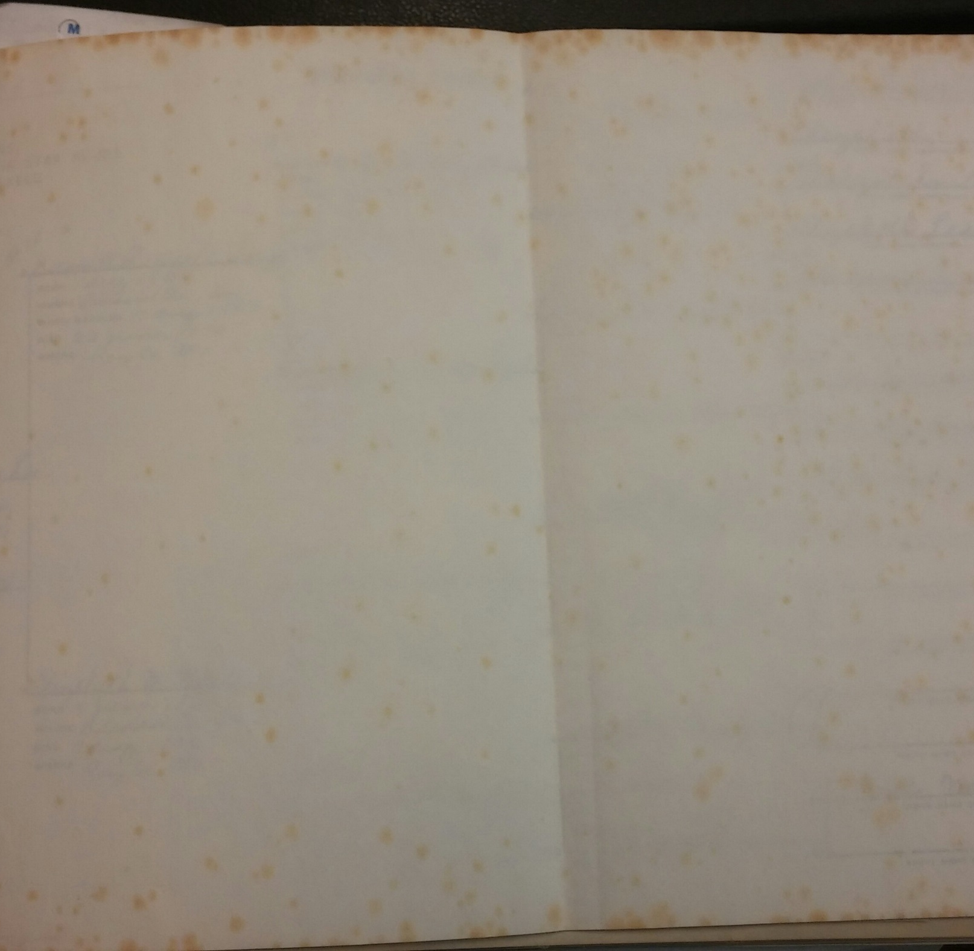
Foxing
Foxing can occur in scrapbooks and on certificates. It is an age related process. High humidity could be a contributing factor as well as mold and metal contaminates

Slide 8
Prevention
Environment, Supplies, and Incoming Collections

Slide 9
Preservation vs Conservation
All archivists, librarians, and museum professionals can practice preventative measures to preserve paper collections
Preventative measures include housing items in acid free enclosures, keeping the collections in an environment conducive to preservation
According to the National Archives “Conservation attempts to preserve records in their original format.” In a sense we also practice conservation, however conservators are their own special field.
Conservation is usually what happens when an item is to far gone for preventative measures to work any more.

Slide 10
Environment
The temperature should be no higher than 70 degrees
In general the lower the temperature the better
Humidity should be between 30-50%
You really want to make sure that the temperature and humidity fluctuate as little as possible
For every 5 degrees that the temperature goes up the reaction time for deterioration doubles

Slide 11
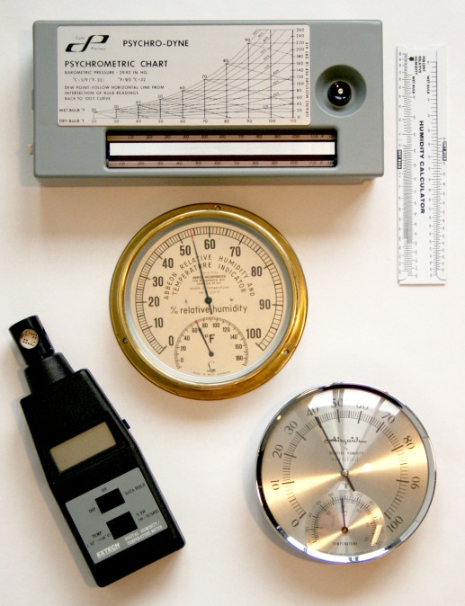
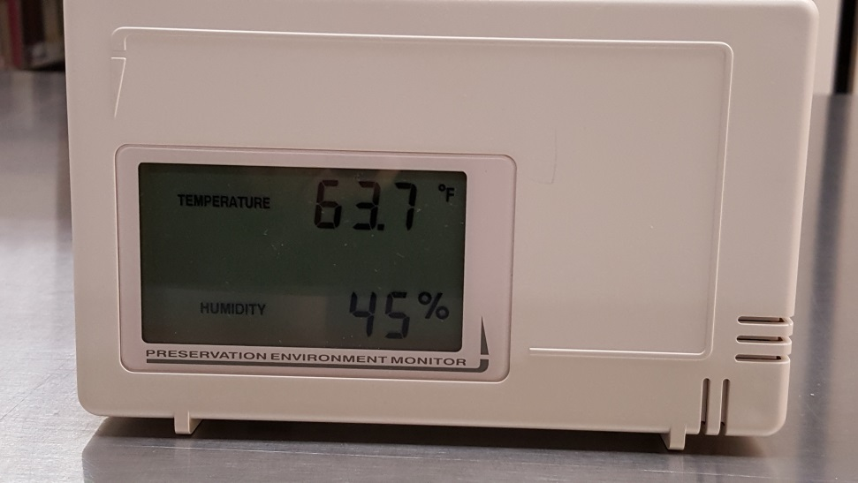
Measuring Tools
Courtesy of the Northeast Document Conservation Center Website https://www.nedcc.org/free-resources/preservation-leaflets/2.-the-environment/2.2-monitoring-temperature-and-relative-humidity
Notes:
The thermometer on the right is the one that we use in our stacks. The image on the left is a variety of different monitoring devices that can be used. You can get these for relatively cheap.

Slide 12
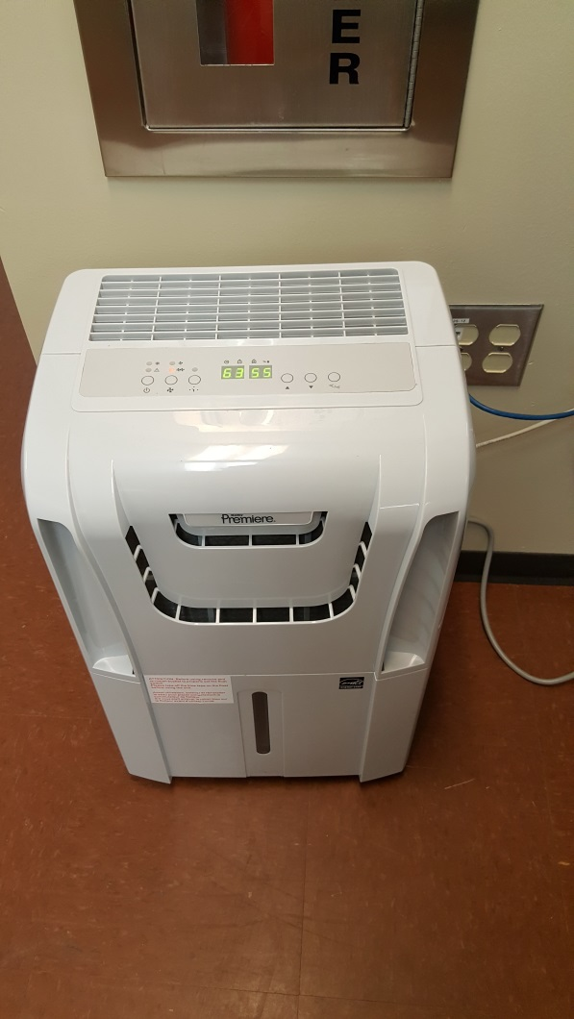
Dehumidifier
Notes:
We use dehumidifiers in the collections area to make sure that the humidity stays below 50%. We have 3 in a large room.

Slide 13
Incoming Collections
It is a good idea to instigate a quarantine period for incoming collections to protect existing collections from pests or mold.
At the History Center we have a large freezer that we use to kill any pests that may have come in with the collection
We do not always put collections in the freezer. If we know that the collections have been kept in a clean environment, then we will skip the freezer.
Sometimes the conditions of the collections prevent us from placing them in the freezer.
For manuscript collections, they are then sent to the registration office, which is segregated from the rest of the collections to await accessioning. This acts as the quarantine period.
Notes:
You can use a small chest freezer for this as well, just make sure that it is a self defrosting or Frost Free and that it can reach and maintain temperatures of -20 degrees. The other thing you will want to do before freezing materials is to wrap them in plastic to keep the moisture off of the items.

Slide 14
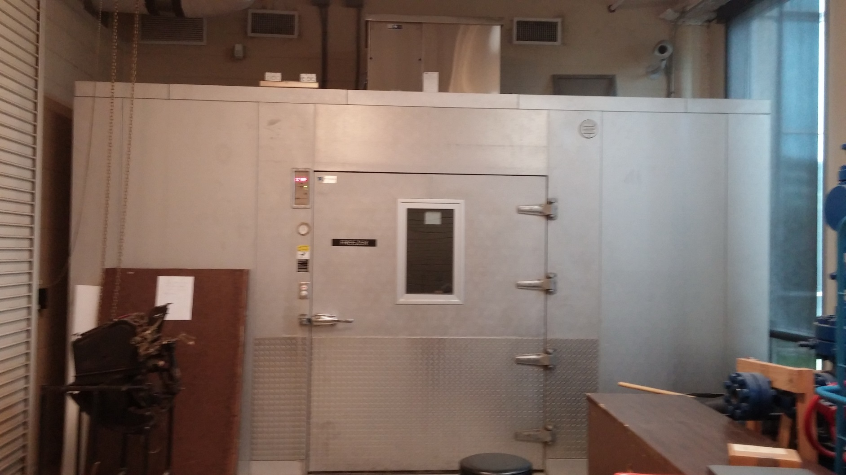
Freezer
Notes:
This is the freezer that we use. The best way to make sure you kill all of the bugs and eggs is to put the materials in the freezer for a week, take it out for a few days and then put the materials back in the freezer.

Slide 15
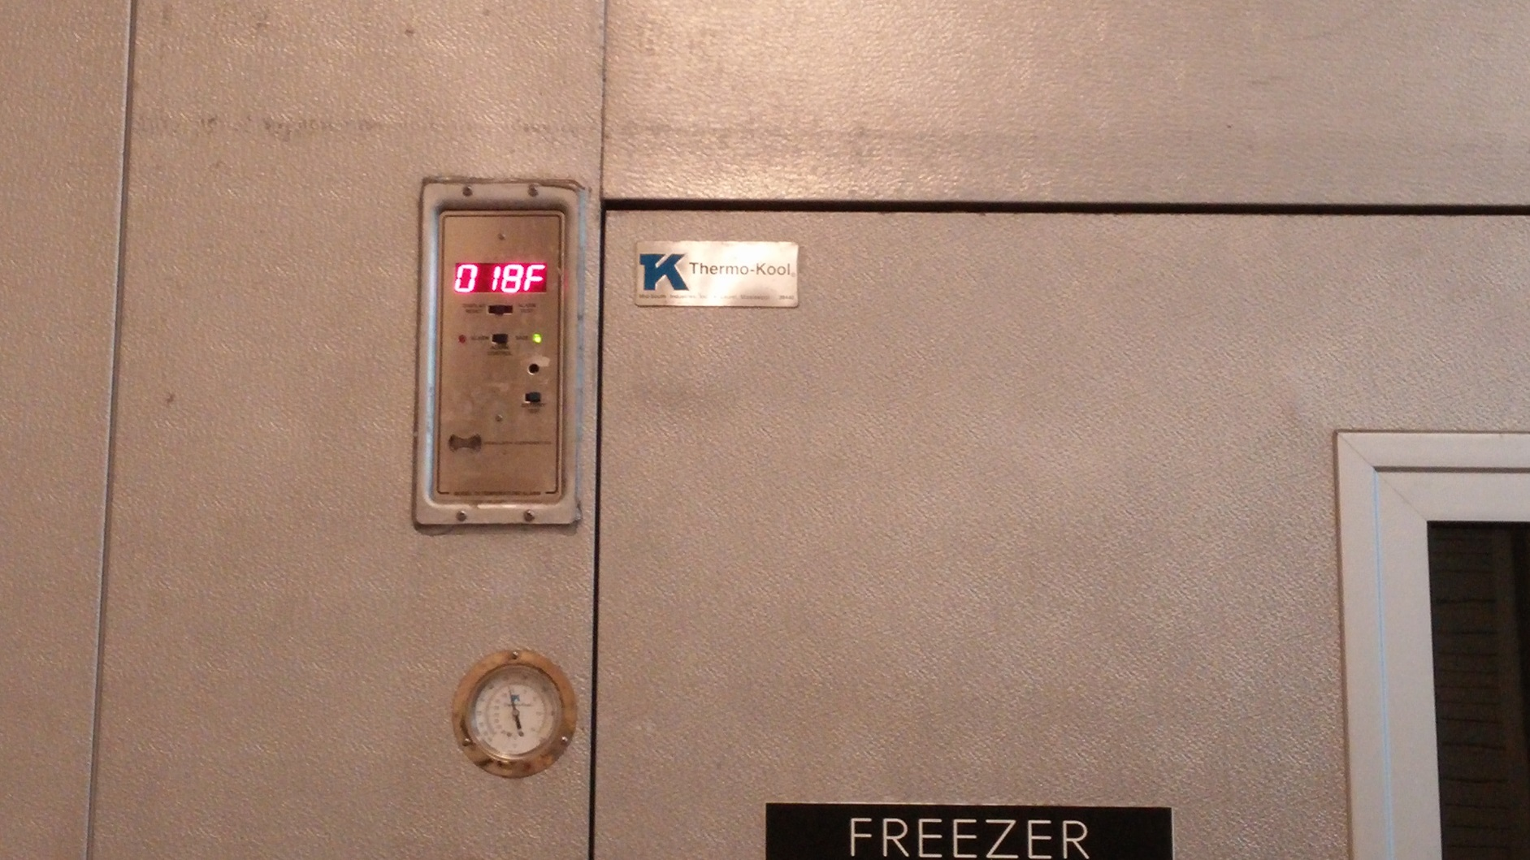
Freezer Temp

Slide 16
Most Commonly Used Supplies
Acid Free Boxes, Folders
Cotton or Nitrile Gloves
Mylar
Photo Sleeves
Acid Free Paper
Abbey Pen (PH Testing Pen)
Pencils
Staple Puller
Plastiklips
UV filters for lights
Dehumidifiers
Sticky traps

Slide 17
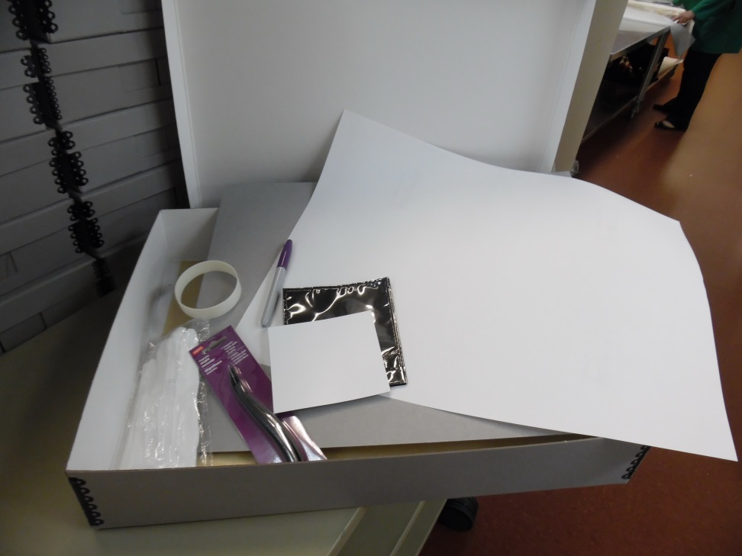
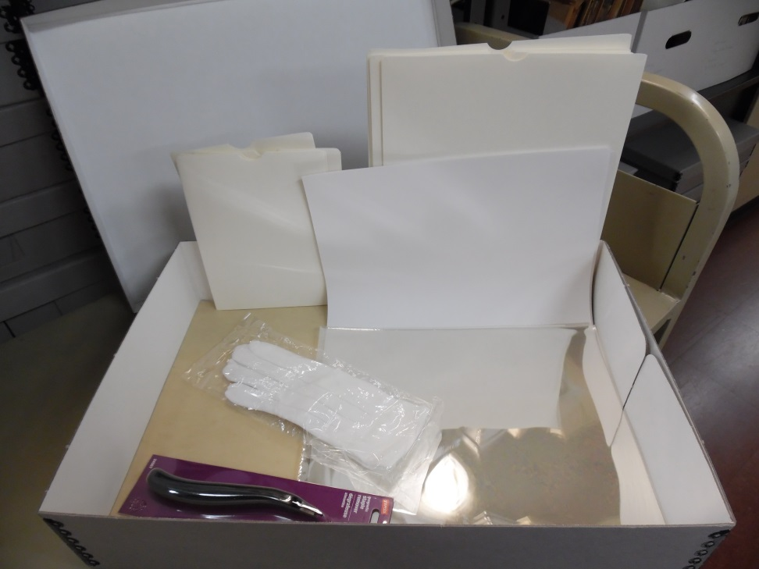
Preservation Supplies

Slide 18
Housing Manuscript Collections

Slide 19
Storing Paper In Different Formats
Loose Documents
Bound Items (Scrapbooks and Ledgers)
Documents can be stored in acid free folders in acid free boxes.
Acid free paper can be used to separate acidic paper, however it is not necessary to put acid free paper between each item.
Remove all staples, paperclips, pins, and metal fastenings
Documents are usually stored vertically, unless they are oversize then they are stored horizontally
You always want to unfold documents as much as you can
Scrapbooks can be left intact or can be taken apart.
If they are left intact, make sure to place acid free paper in between any acidic paper and photos.
If you decide to take apart a scrapbook, make sure to keep the pages in order to preserve context
Ledgers are hard to preserve, usually placing them horizontally in an acid free box is the best way to go
Notes:
Ledgers or leather bound books that have “Red Rot” or have that leather dust when you run a hand over them, should be kept away from other items with leather covers. Red Rot is contagious.

Slide 20
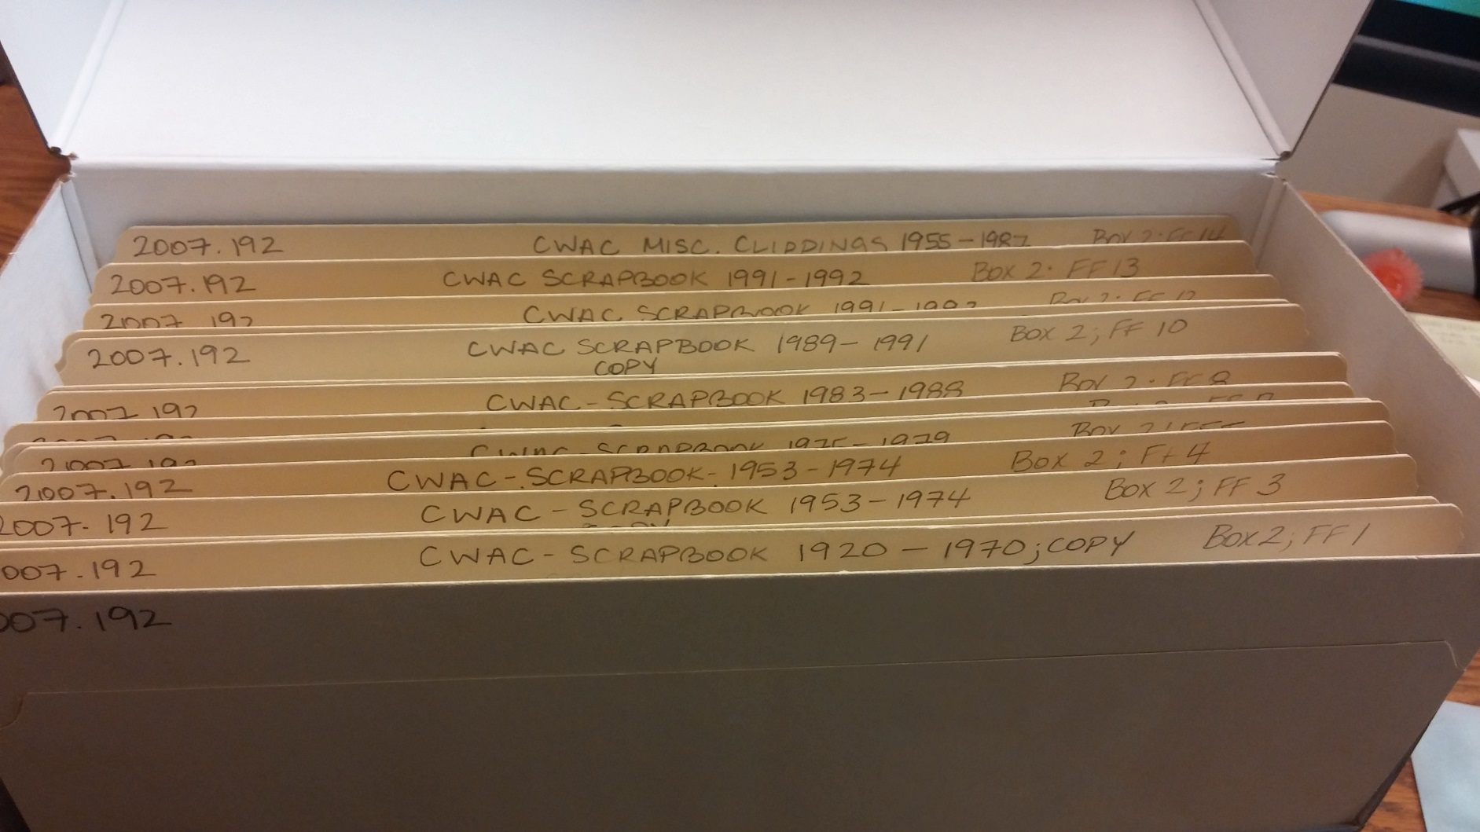
Deconstructed Scrapbook

Slide 21
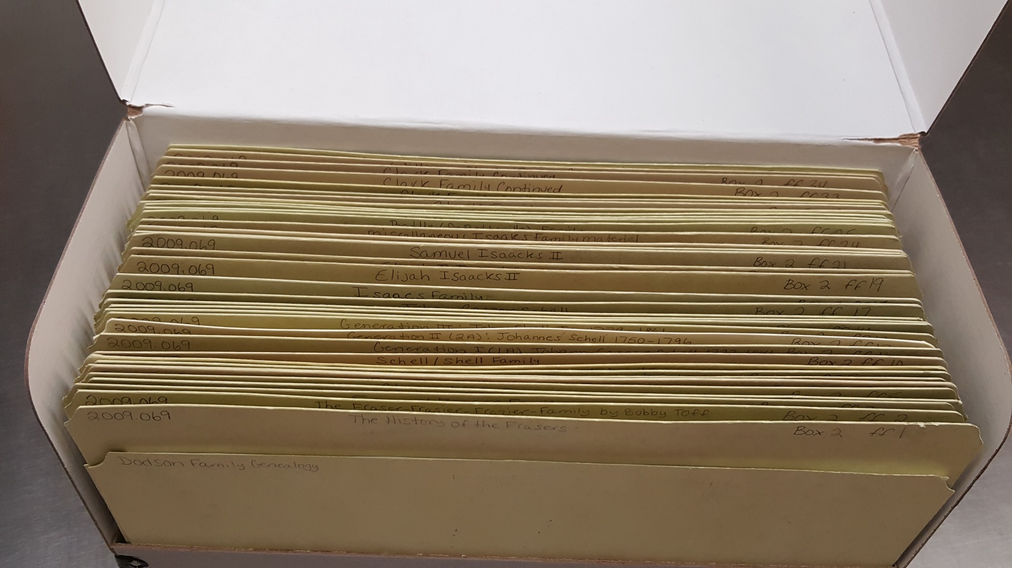
Manuscript Collection

Slide 22
Humidification and Flattening
What to do with rolled items

Slide 23
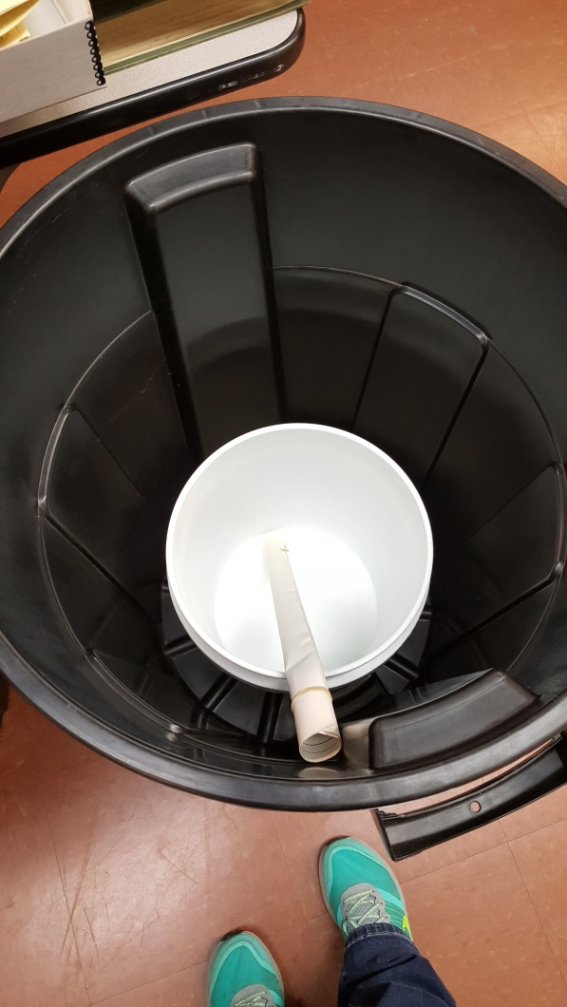
Humidification
Humidification is the act of allowing rolled or folded items to absorb some moisture in order to relax the paper
Humidification chambers do not need to be fancy or complex
Make sure to really watch how long you keep items in the chamber
I check on items in the chamber every hour
For manuscripts, you do not want to leave items in the chamber overnight

Slide 24
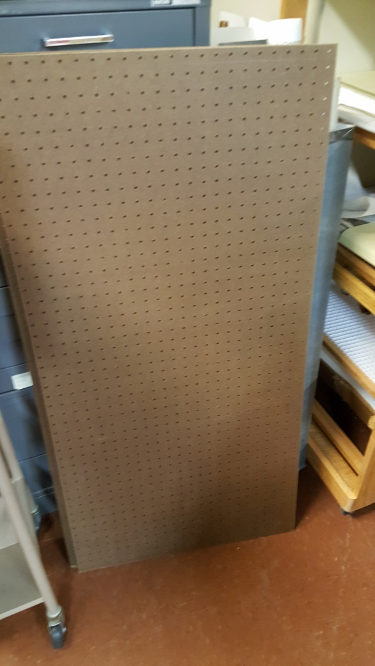
Flattening
Flattening is not an exact science
Depending on how stiff the paper is and what type of paper it is, the flattening process can take anywhere from 2 days to 2 months
You want to make sure to check on the items every couple of days for the first week and then every week until complete
You may need to rotate or flip documents in order to achieve even flattening

Slide 25
Digitization and Photocopying
A Valid Approach to Preserving Paper Based Collections

Slide 26
Digitization as a Form of Preservation
Digitization as a form of preservation has been a controversial subject over the last several years
This concept gives archives, libraries, and museums a way to preserve at risk collections
TIFF formats should be used
A master copy and an access copy should be made to preserve the quality of the digital item

Slide 27
Pros and Cons of Digitization
Pros
Cons
Collections can be made available online, decreasing the need to pull the originals
Allows you to preserve documents, scrapbooks, ledgers and other items that may not survive for much longer
If something has deteriorated past the point of no return, you can still keep a record of the item through digitization
Digitizing is time consuming and can be costly
Digital media still has an uncertain future
Does not always stop family members or friends from wanting to see the originals

Slide 28
Photocopying
I always recommend photocopying newspaper clippings and articles and throwing the original away
Making photocopies of certain collections for the public to use has also been used in the past to preserve the original documents
The damage caused by photocopying an item too many times will come from the additional handling and from the light of the copy machine
Other than newspaper clippings and items that you will discard after copying, I would recommend scanning items.

Slide 29
Preservation of Photos
Environment, Housing, and Most Common Types of Photos

Slide 30
Basic Photo Care
Keep photos in a cool, dry environment
Warm damp environments equals mold
Environments that are too dry lead to brittle photos
Store in acid free (museum quality) sleeves or boxes when possible
Negatives should be stored away from print materials
Remove photos from acidic (cardboard, wood, construction paper) mounts when possible

Slide 31
Things To Avoid
Magnetic or “no stick” photo albums
  Use photo corners in scrapbooks
Fastenings (paperclips, rubber bands)
  If you need to clip photos together, use plastic clips
Writing on the back of the photo
  Make a copy on acid free paper and write on the copy. Keep the two together
Using pen or marker to mark on the photo or enclosure
  Use pencil
Trying to repair a photo
  Make a scan of photos that are fragile
  Take the original to a conservator

Slide 32
Types of Photographs
Daguerreotypes
Ambrotypes
Tintypes
Albumen Prints
Cyanotypes
Photo prints
Negatives

Slide 33
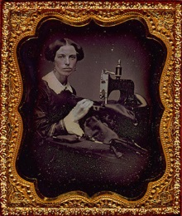
Daguerreotypes
Popular from the 1840s to the 1860s
Usually have protective glass covers
Made on a sheet of highly polished silver-plated copper
Could not be reproduced
Preservation tips:
  Do not try to clean or remove the glass without a conservator
  Do not place in cold storage or in plastic sleeves
  Never touch the surface of the image any fingerprints or scratches will be permanent
  Try to store the images glass side down or on their side
http://www.loc.gov/pictures/collection/gag/mirror.html
Notes:
Daguerreotypes were one of the only 2 types of photos made directly on a metal plate without negatives. They are usually reflective

Slide 34
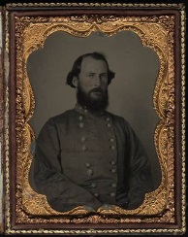
Ambrotypes
Made of Glass
Popular from 1851-1880
Easier to produce and cheaper than Daguerreotypes
Could not be reproduced
Preservation tips:
  Do Not store in plastic sleeves
  Do not take out of the glass case. Oxidization will occur on contact with air
  Try to store vertically with spacers in between each plate
  Avoid wood cabinets for storage
http://www.2.lib.unc.edu/ncc/pcoll/inv/P0007.html

Slide 35
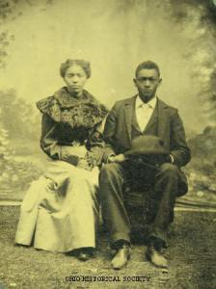
Tintypes
Introduced by Hamilton L. Smith in 1856
Descendent of Daguerreotypes and Ambrotypes
More durable form of photographs
Made of thin iron plates
Can also be called Ferrotypes and Melainotypes
Tintypes can now be reproduced with modern methods
Preservation tips:
  Wear cotton, latex, or Nitrile gloves
  Do not remove broken glass
  Do not try to flatten dents in the plates, the emulsion can crack and fall off
  Store in acid free polyester or paper sleeves
  Try to store vertically with spacers between each plate
https://ohiohistory.wordpress.com/2011/08/05/what-do-you-know-about-tintypes/
Notes:
Tintypes were used as late as the 1930s.
Can be identified by their dull, flat finish. They can sometimes have hand coloring
To distinguish a Tintype from an Ambrotype, see if a magnet will stick to the back of the case.
Could not be reproduced unless an entirely new photograph was taken
No Negatives were used

Slide 36
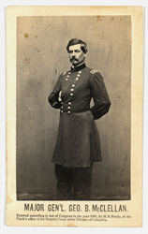
Albumen Prints
Popular from 1851-1900s
Created by Louis Blanquart-Everard
Prints are extremely sensitive to moisture
Try not to touch the emulsion
Don’t try to unroll the prints
Characterized by a smooth, shiny surface, which is the result of a coating of egg whites (Albumen)
Store in a clear polyester envelopes
Image courtesy of the Library of Congress
Notes:
Albumen Prints have silver added to egg whites that are coated on paper

Slide 37
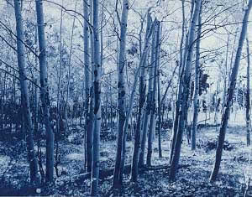
Cyanotypes
Popular from 1880-1910
Made from iron salts
Still used today
Take the form of blueprints
Be gentle with the paper, it is fragile
Don’t expose Cynotypes to light or put next to buffered paper
Store in metal cabinets, avoid wood cabinets
Do not try to unroll brittle or fragile cyanotypes without the aid of a conservator
Image courtesy of DePaul University
Notes:
Cyanotypes can be on paper or cloth. They have a Prussian Blue Dye added. They can be other colors, but that is very rare

Slide 38
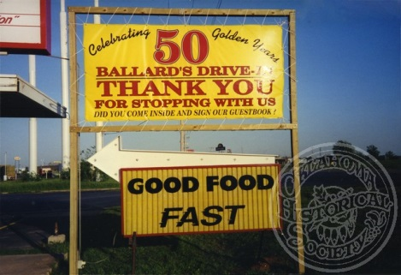
Print Photographs
Introduction of wet collodion plates made the duplication of photographs possible
Early print photos arrived in 1880s
There have been several different types of emulsions over the years
Over time color photos will start to turn yellow because the blue dye is fading
Preservation tips:
  Heavily damaged photos or tightly rolled photos should be taken to a conservator
  Use photo corners in place of adhesives
  Avoid writing on the backs of photos
Image courtesy of the Oklahoma Historical Society P2012.162.01

Slide 39
Negatives
Negatives should be stored away from the photo prints
Use acid free plastic (Polyethylene) strip storage or buffered paper enclosures
Make sure to keep negatives in a cool, dry, dark environment

Slide 40
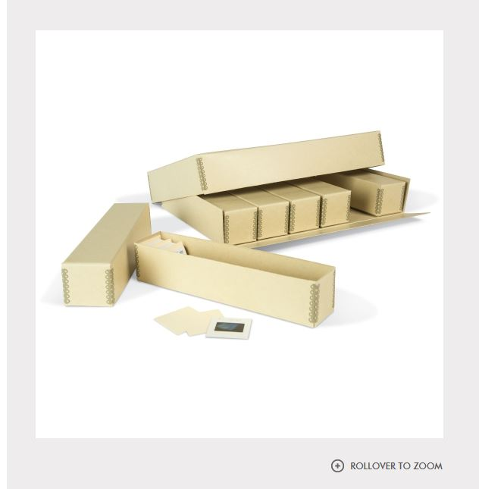
Slides
Keep slides in a cool dark environment
You can store slides in archival plastic sleeves. The slides need to be put in individual pockets
The plastic sleeves will allow for viewing without the risk of damaging the slides with fingerprints
You can also store slides in special acid free slide boxes
Slides can be digitized very easily. There a several machines that you can buy to do this at home.
Notes:
The slide machines are not expensive. I was able to find one, new in a box at a thrift store for $5.00

Slide 41
Supplies
How to make sure you have acid free supplies and what is most commonly used

Slide 42

How to Determine Whether Your Materials are Acid Free
Materials should have a lignin free or acid free designation
A good way to tell is if they have passed the PAT (Photographic Activity Test)
Should have a pH of 8.0-9.0
Notes:
Photographic Activity Test assures that the materials will not react with photographs and are tested to withstand acid migration. It means that the materials were acid free at the time of manufacture.

Slide 43
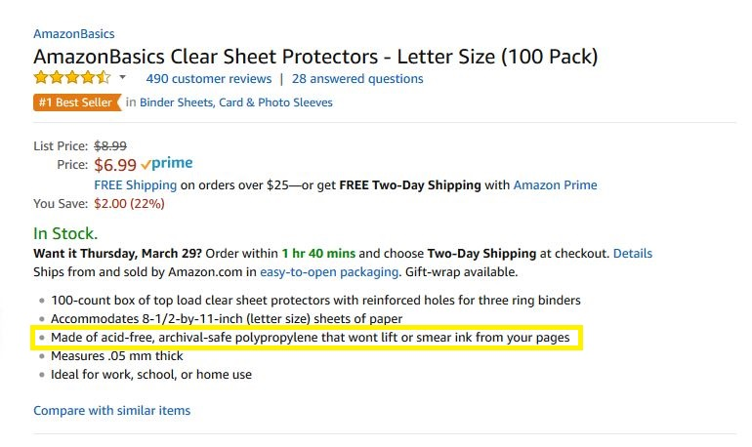
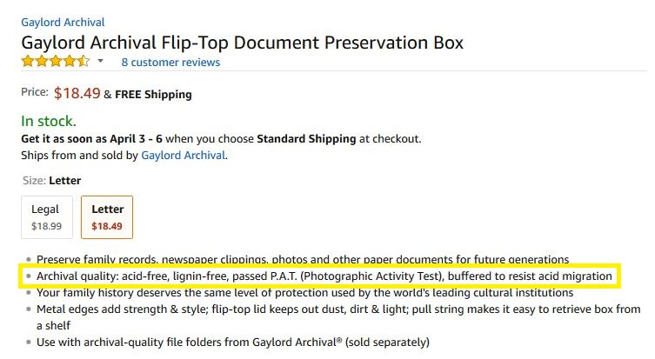
Comparison of Amazon Listings
Notes:
There are no regulations regarding what can and cannot be labelled as acid free or museum quality so it is better to stick with well known brands or items that have passed the PAT Test. When in doubt use your abbey pen to test the pH.

Slide 44
Most Commonly Used Supplies
Pencil
Photo Sleeves
  Paper
  Plastic
Plastiklips
Acid free boxes
Negative Sleeves
Slide boxes

Slide 45
Digitization
Pros, Cons, and Tips

Slide 46
Digital Files
You should always have a master copy and an access copy
Files should always have a unique file name to make finding individual photos easy
Make sure to have copies of your photos in at least 3 different places. Two should be as far away from your house as you can manage
Make sure to update your files regularly
If you use photo organizing software, make sure to update your software to make sure you always have access to your photos.

Slide 47
Should I Digitize my photos?
Pros
Cons
Save original photos from handling
You can use a good quality scan to put in a frame
If there is a disaster you will still have digital copies as back ups
Digitizing is time consuming
Digital files have an unknown shelf life
Digitizing can be expensive

