Slide 1
Seed saving

Slide 2
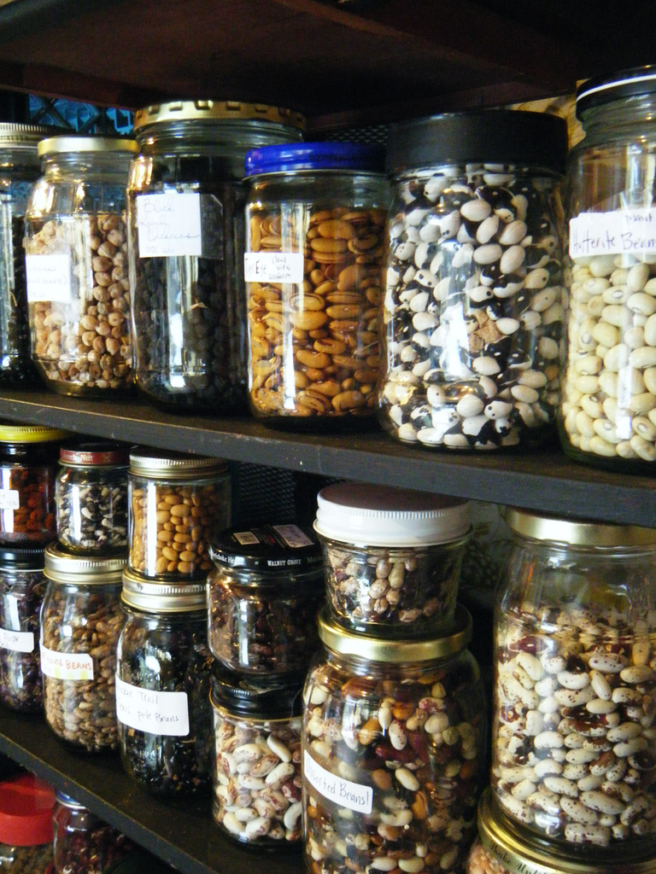
Why save seeds?
Preserve excellent varieties
Preserve heritage
Breed new varieties
Save money

Slide 3
Is it hard?
No!
Yes!
Where do heirlooms come from anyway?

Slide 4
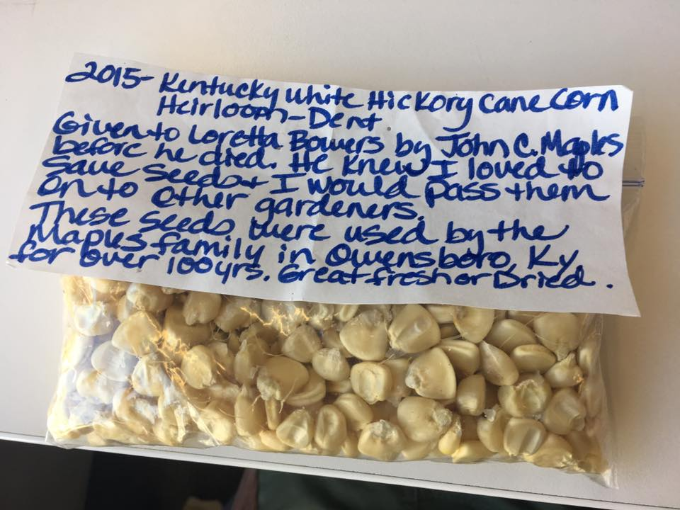

Slide 5
How to save seeds
1. Grow your garden.
2. Isolate the varieties you want to save seed from.
3. Choose the best plants—strongest, tastiest, prettiest or most productive—and let them go to seed and ripen fully.
4. Optional: wet-process seeds from wet fruits, like tomatoes, by soaking the seedy pulp 2-3 days in a jar of water, then rinsing.
5. Dry all seeds completely.
6. Label them.
7. Store in a sealed container in a cool dark place.

Slide 6
Get to know your plant
Learn the plant’s latin name
Find out how the plant pollinates
Find any cousins in the neighborhood

Slide 7
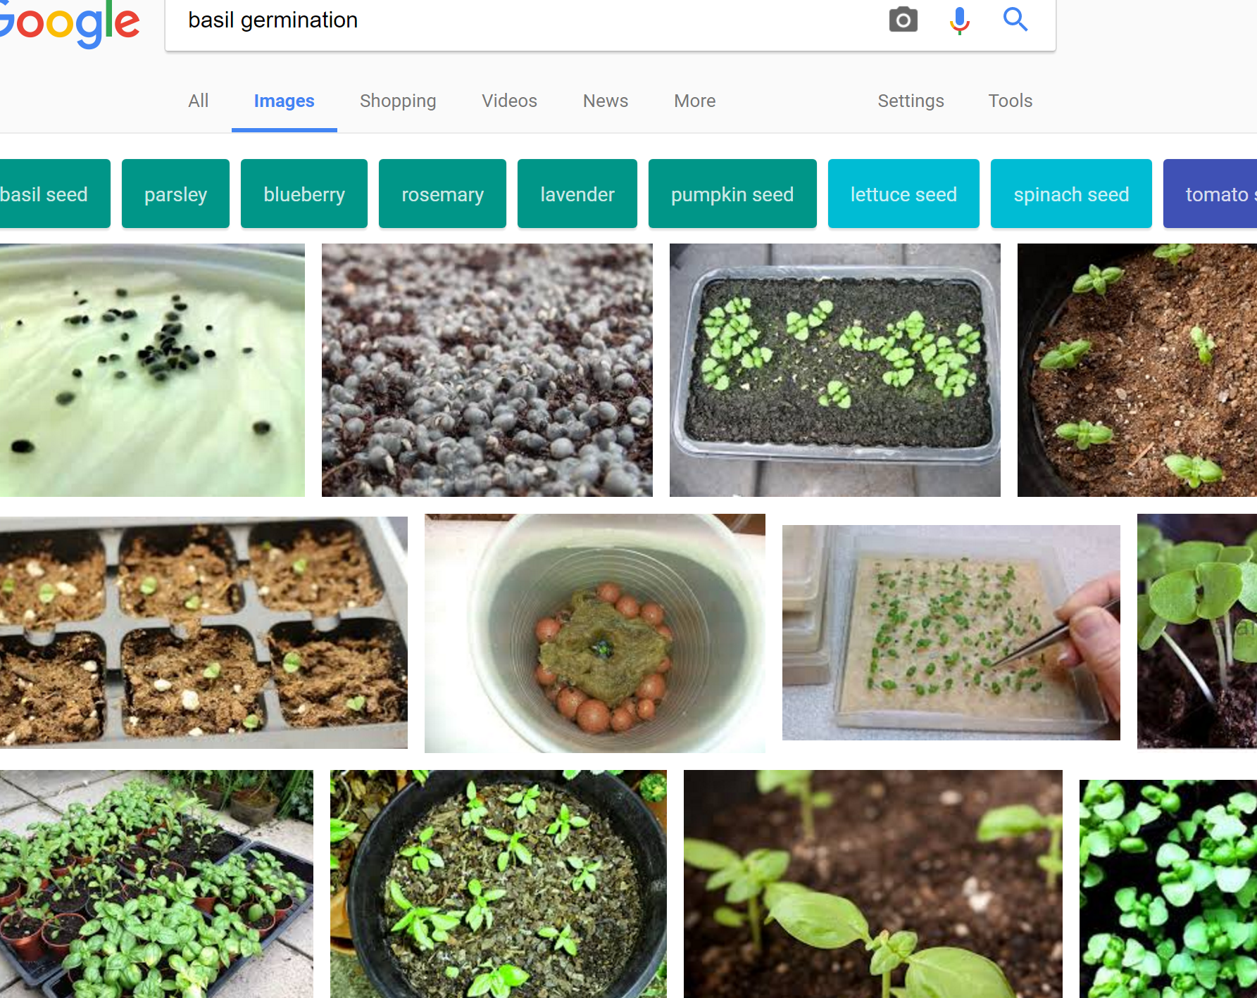
My favorite gardening tool

Slide 8
Where do
plant babies come from?

Slide 9
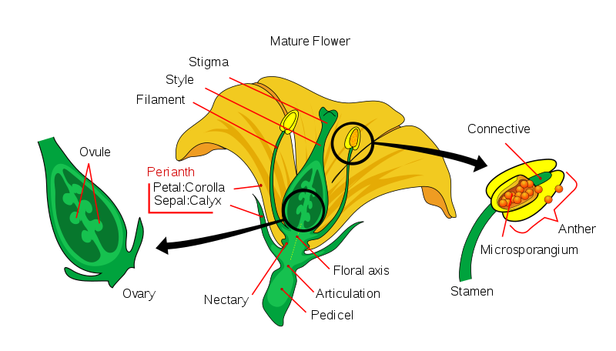
Pollination

Slide 10
Self-pollinators vs.
Cross-pollinators
Peas
Beans
Lettuce
Tomatoes
Brassicas: cabbage, kale, Brussel sprouts, bok choi, mustard, broccoli, collards
Cucurbits: squash, zucchini, pumpkin
Cucumis: melons, cucumbers

Slide 11
Hybrids vs. open-pollinated
Reliable plants
Disease resistant
Shelf-life
Uniform
Not saveable
Variable plants
Flavor
Adaptable
Funky
Saveable

Slide 12
Isolation
Distance
Time
Barriers
Manual manipulation

Slide 13
Storage and labeling
Cool, dark, dry
Stable
Write down as much as possible

Slide 14
Why seeds in a library?
Engagement
Community resilience
Information needs

Slide 15
Engagement
Circulation numbers
Foot traffic
Buzz
Returning users
User-built collection

Slide 16
Information needs
Gardeners’ stories
Food stories
Seeds as books

Slide 17
Goals
Articulate
Evaluate
Evolve

Slide 18

How to Start a Seed Library
Suggestions and things to consider

Slide 19
Legal Aspects
Each state has laws protecting seed consumers and require germination testing.
Oklahoma laws specify that this applies to commercial ventures and does not cover lending or seeds that were given away.
If anyone is from surrounding states, be sure to check your local statutes.

Slide 20
Budget
Budget will effect any future decisions- what seeds to purchase, how to package them, etc.
Consider the money and time you can devote to this project.
Set realistic goals for the budget you have

Slide 21
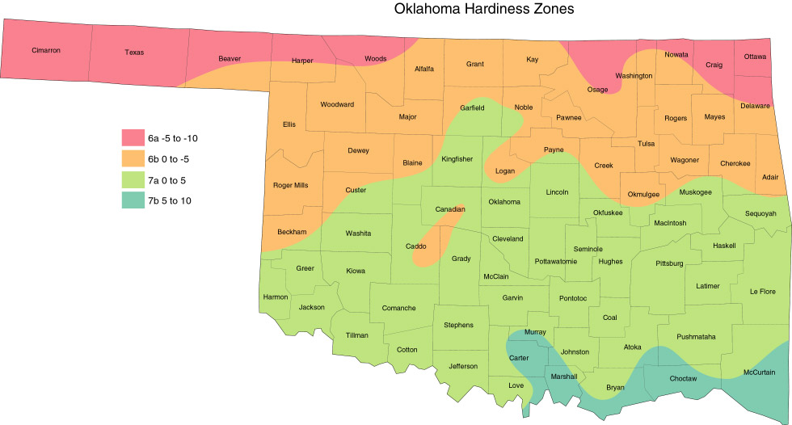
How do I know what seeds to buy?
Climate
Cost
Population
How do they match your goals? (Food vs. aesthetic plants, pollinators, heirlooms)
Ask for help! County Extensions, local gardening groups, etc.
https://www.hort.purdue.edu/newcrop/cropmap/oklahoma/default.html

Slide 22
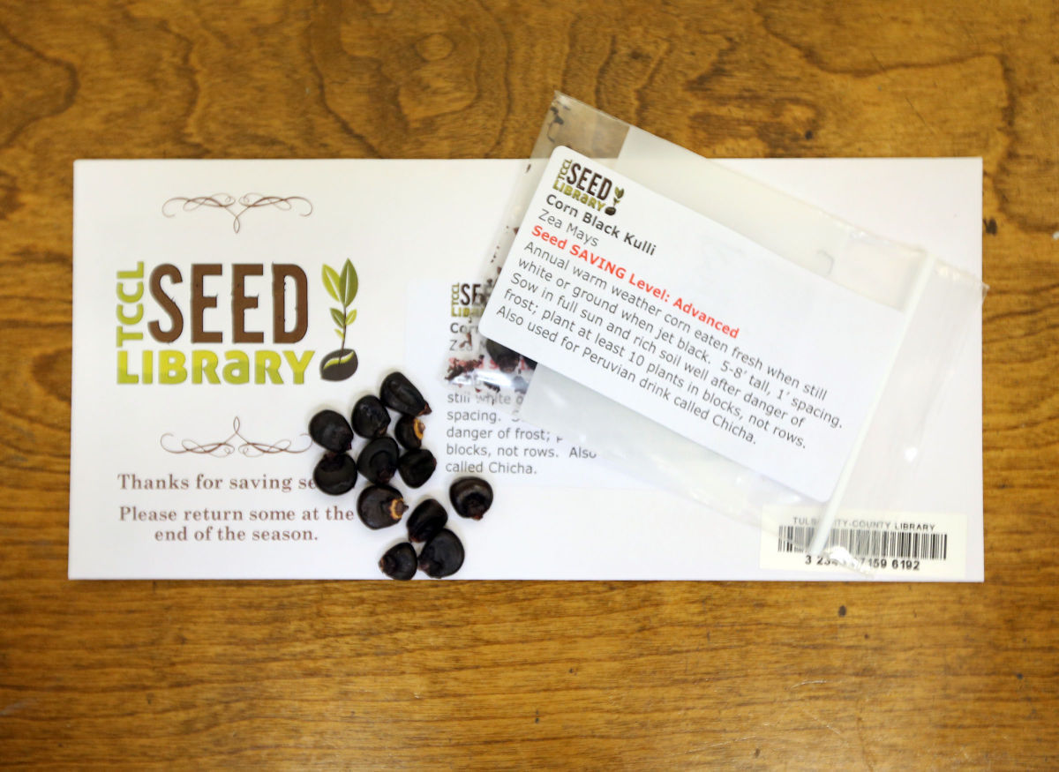
Physical Processing
Create bibliographic records for each variety of seed
Hang on to your commercial packets!
To barcode or not to barcode?
Cory Young, Tulsa World

Slide 23
Set Circulation Policies
5 packets per patron for each of the 4 growing seasons.
Seed packets ‘fall off’ the record quarterly
We allow patrons to place holds to be sent to other branches
Again, a question of gathering statistics vs. available time

Slide 24
Keeping Statistics
Goals vs. Results
Justify expenditures
Help plan for future seasons

Slide 25
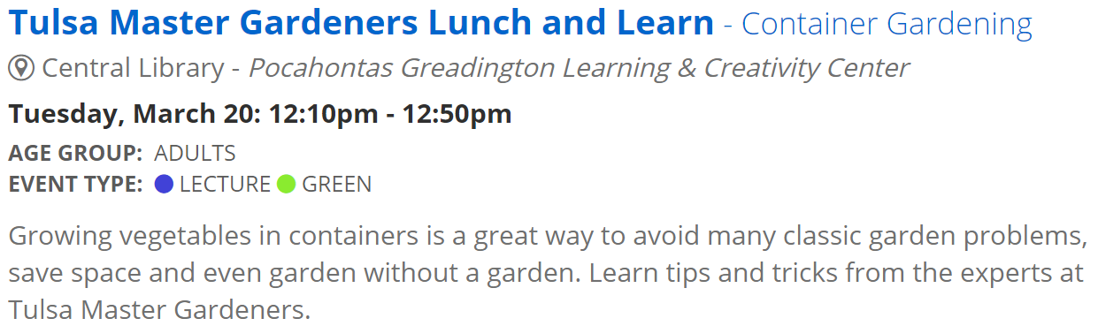
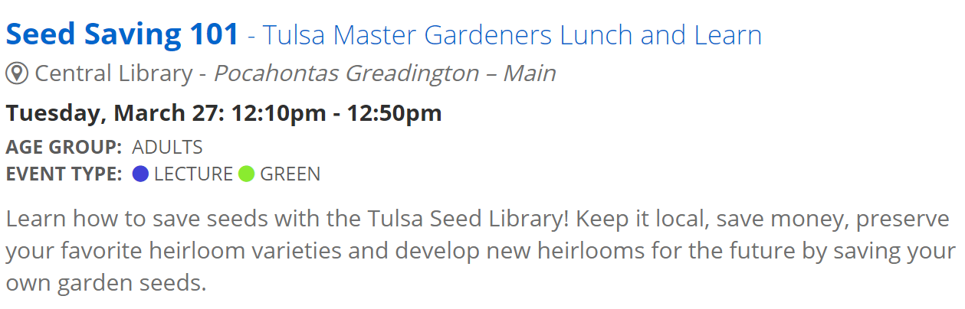
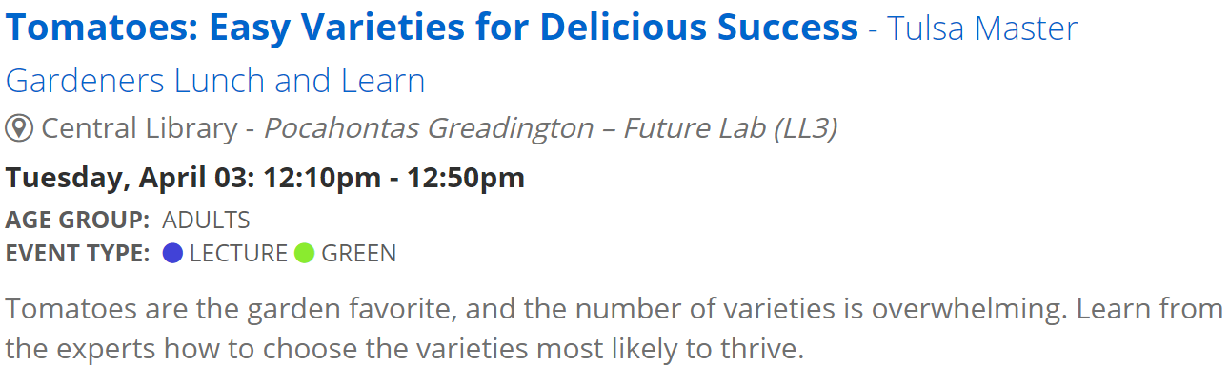
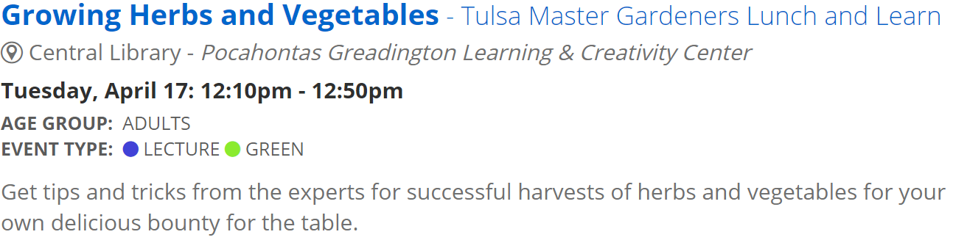
Partnerships and Donations
What are organizations in your community already doing?
Programming to promote and educate
Have a written policy for donations- not all donated seeds are appropriate for seed libraries.

Slide 26
Handling Growth and Expansion
This will grow as large as your budget and time allowance will let it
Ensure that growth is sustainable
Set reasonable goals

Slide 27
Common Issues
Seed packets walking out the door
Unfilled holds
Too many seeds in packets
How to handle strange donations

Slide 28
Tulsa Seed library
Johanna Burton
jburton at tulsalibrary.org
918-549-7415

