Slide 1
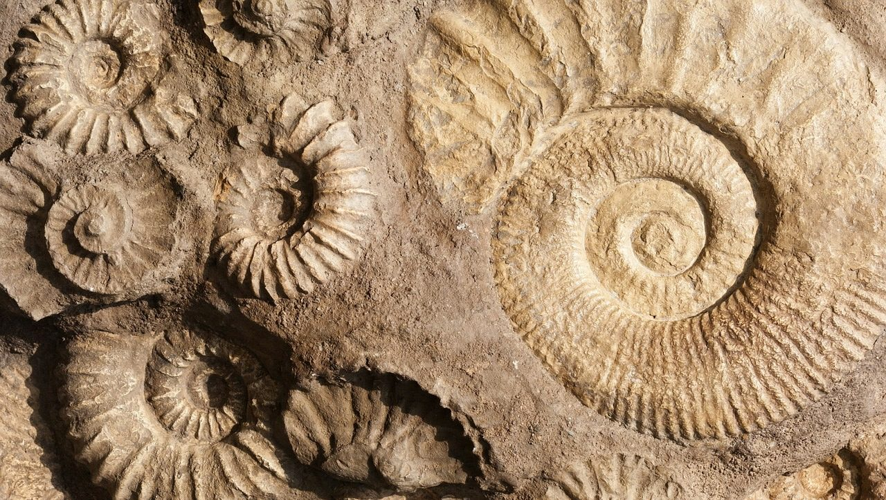
Choose Your Own
Adventure!

Slide 2
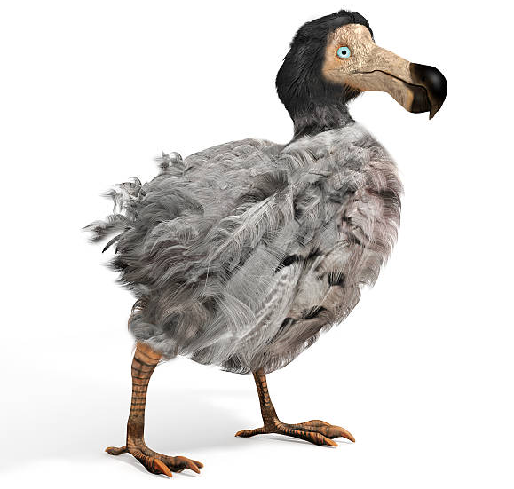
Meet Dodo, the extinct creature you will begin your adventure with!

Slide 3
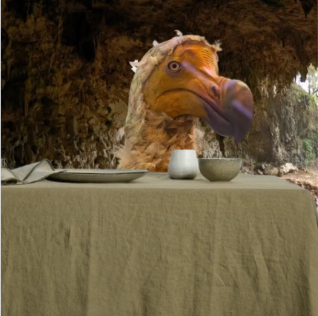
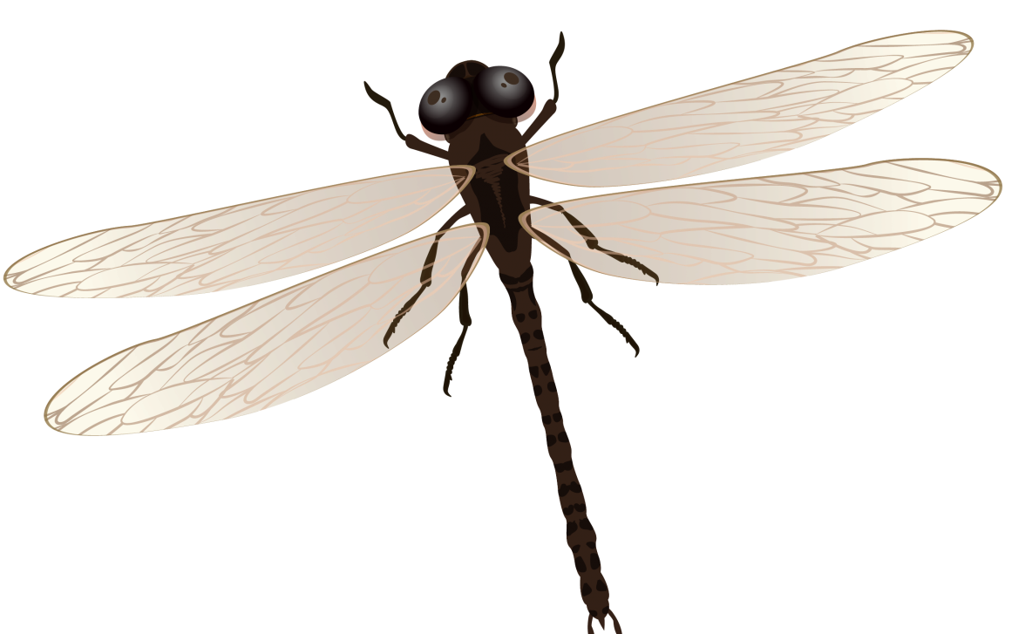
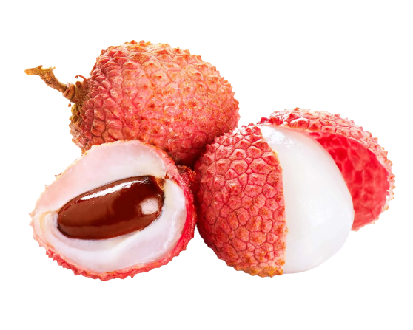
Good morning sunshine! What will you have for breakfast?
OR
Lychee
Giant Bug

Slide 4
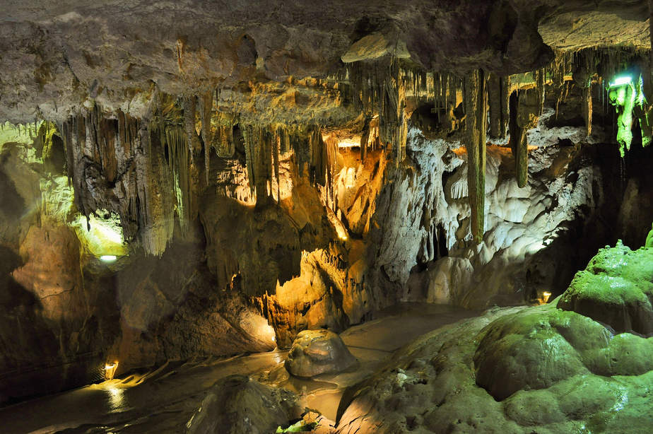
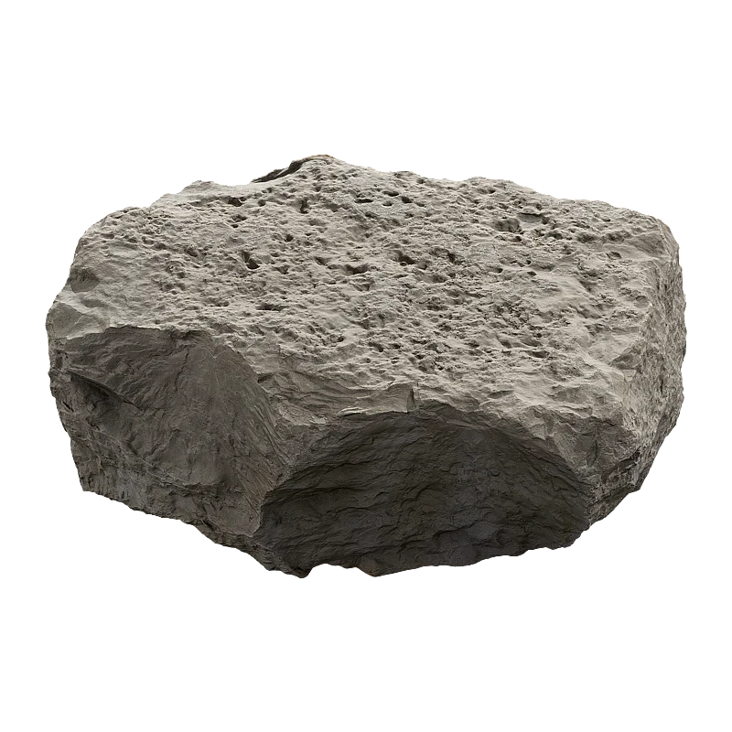
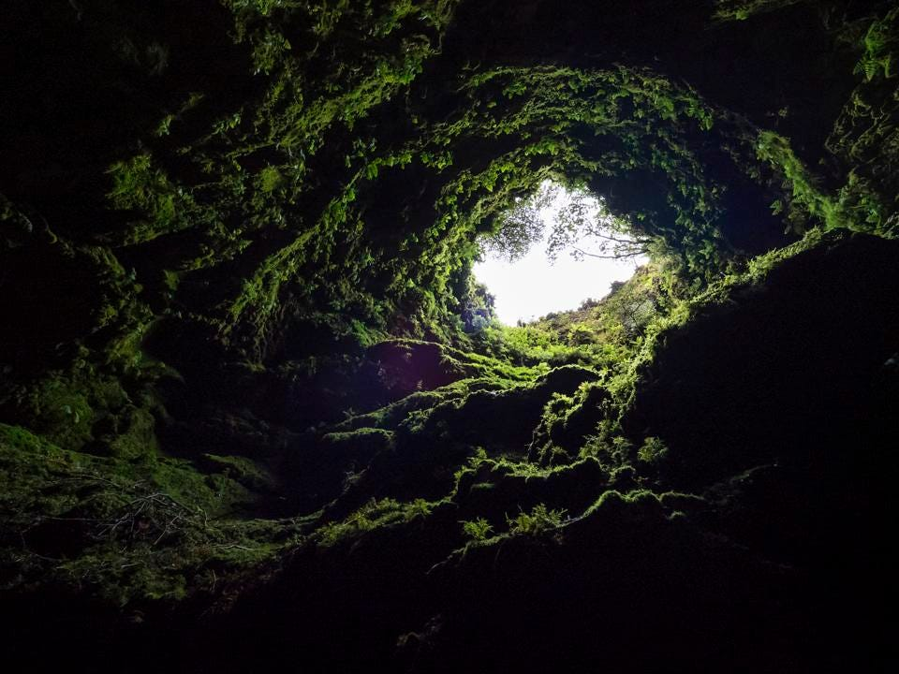
Yum! Dodos LOVE fruit and seeds. They also really liked to eat rocks, so your buddy will have one too. What’s next?
Go for a walk around your cave
Leave the cave and explore outside

Slide 5
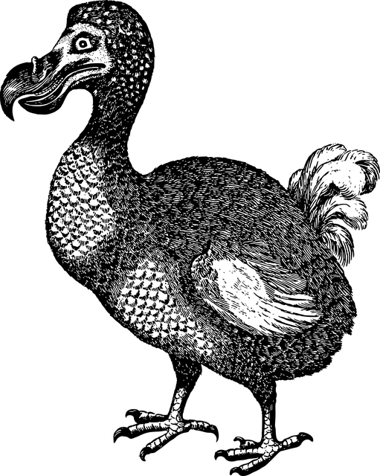
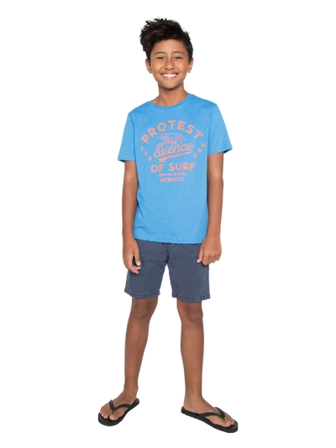
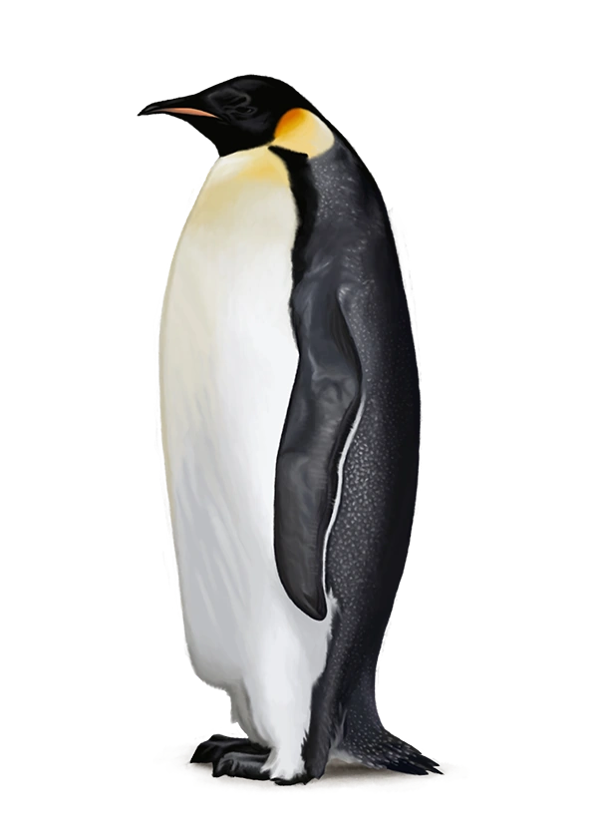
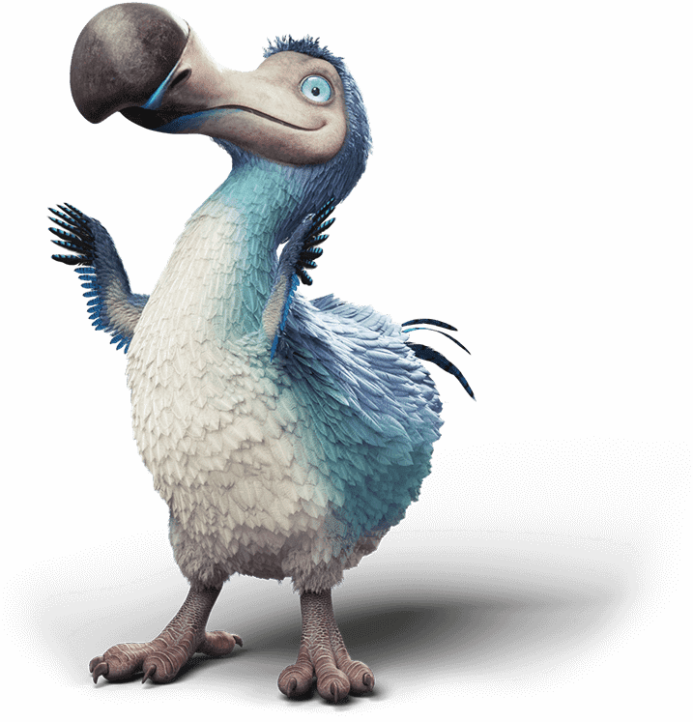
We love a cozy cave walk! Dodos were 3ft tall! How tall are you? You may have to duck when you walk under stalactites! Now that you’re in the cave, your Dodo would like you to draw it’s portrait!
Draw your Dodo!
Tell them no no!
7’1
4’5
3’3
4’0

Slide 6
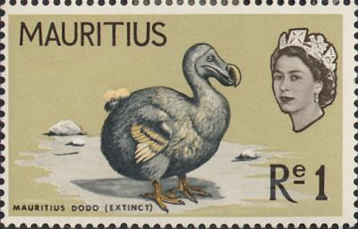
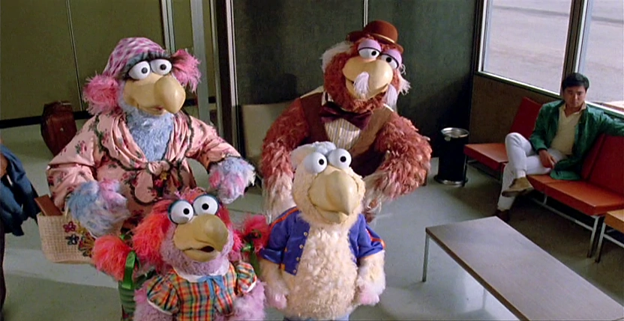
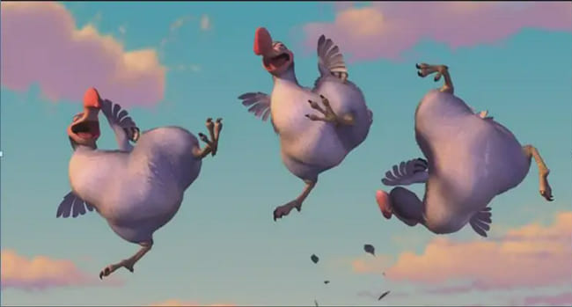
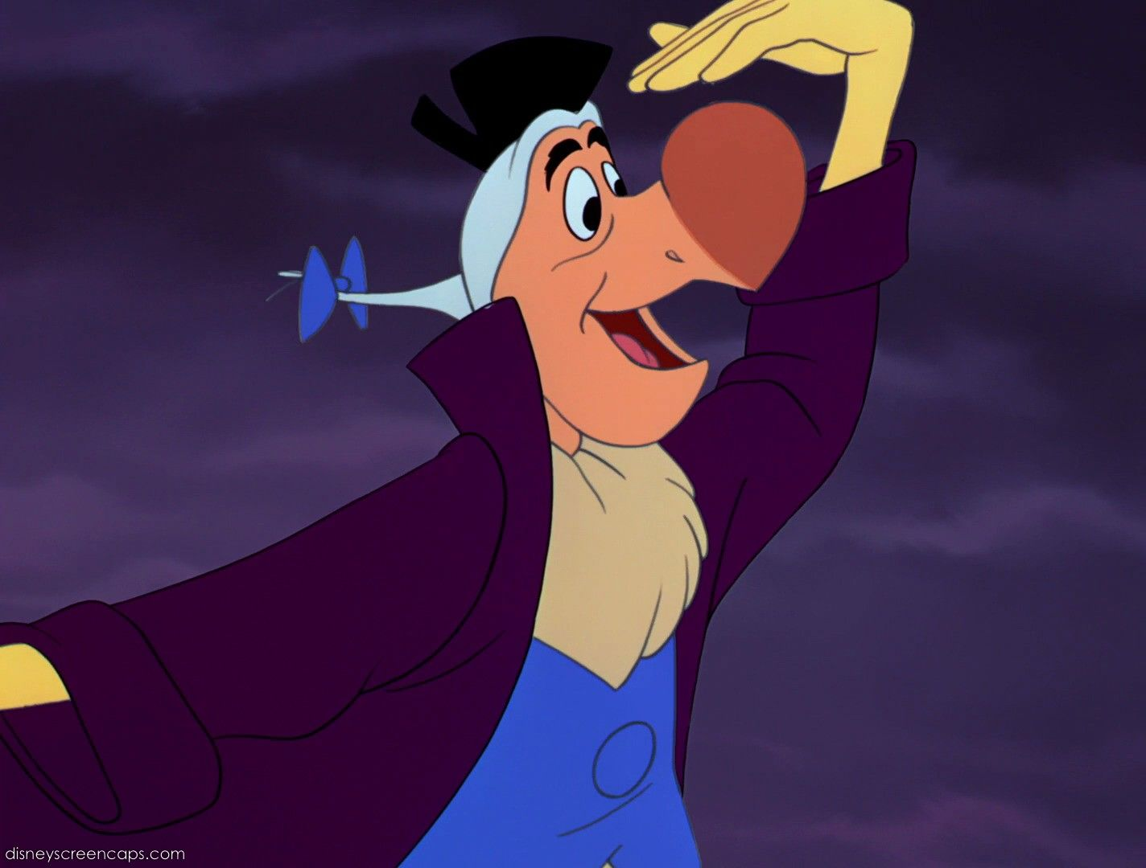
Your fancy portrait will let your Dodo be remembered throughout history! Check out all the famous places your Dodo’s famous face has showed up!
A stamp from Mauritius, their home island!
Click on the stack of books for more books featuring the Dodo!
Muppets from Follow that Bird
The Mauritius Coat of Arms
The movie Ice Age showing off their
Taekwondo Skills
The 1951 movie Alice in Wonderland, inspired by Lewis Carroll’s book of the same title.

Slide 7
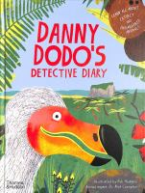
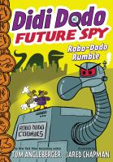
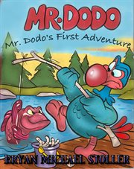
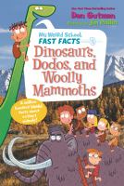
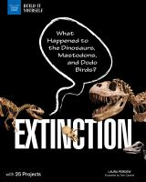
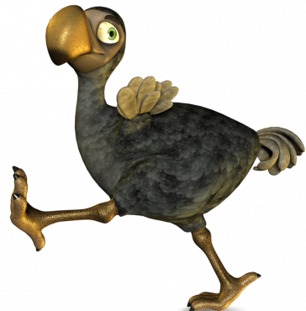
Dodo is off to the Library to read more!
Click here to learn about other extinct creatures!

Slide 8
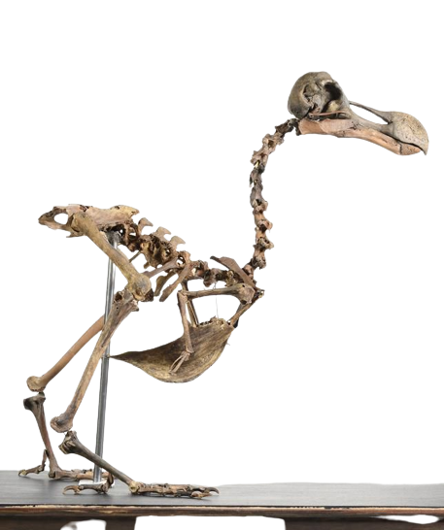
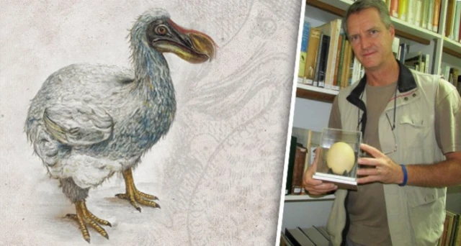
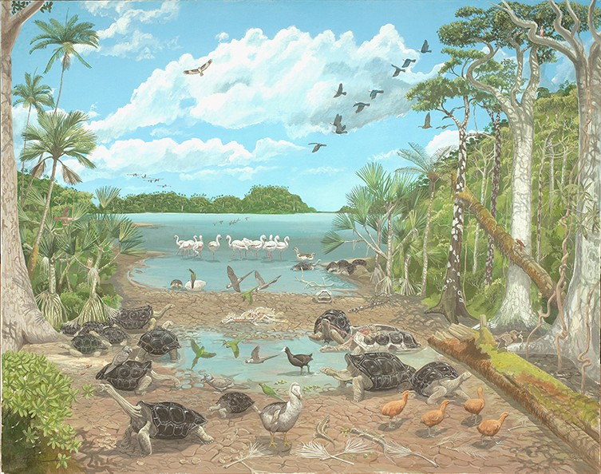
History will have to learn about the Dodo from fossils and reading records from people who have visited Mauritius, their home island.
An archeologist with an example of a Dodo egg.
Click on the stack of books for more books featuring the Dodo!
Few complete skeletons exist of the Dodo
Dr Julian Hume's reconstruction of what Mauritius could have looked like in the time of the dodo © Julian Hume

Slide 9
Dodo is off to the Library to read more!
Click here to learn about other extinct creatures!

Slide 10
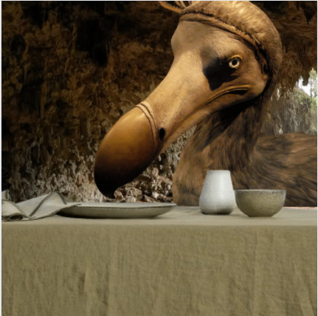
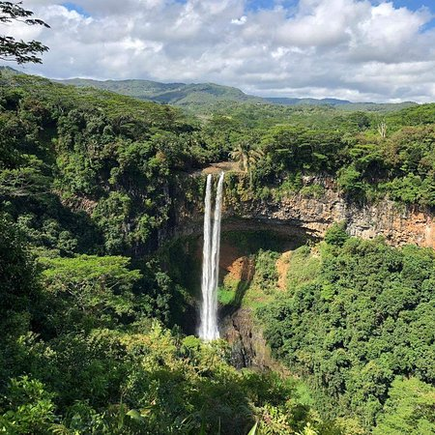
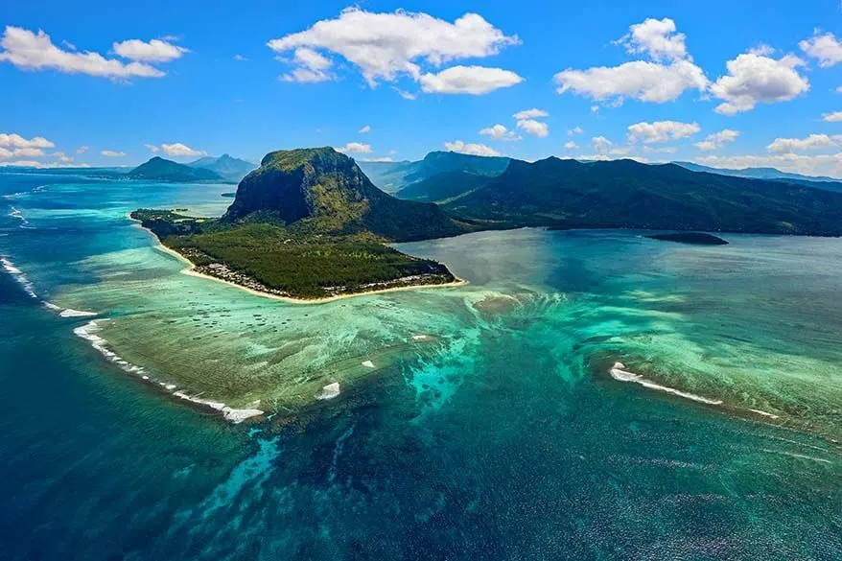
Dodos are omnivores (they ate plants and animals) but they ate fish or crabs. You’re going to need to find your friend a snack when you’re done eating your giant bug.
Go to the Island
Go to the Ocean

Slide 11
Ah, the great outdoors. What fun! Where are you two headed?
Go to the Island
Go to the Ocean

Slide 12
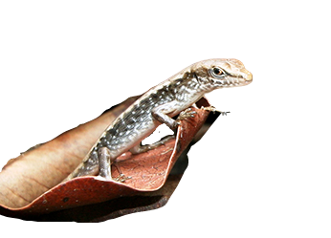
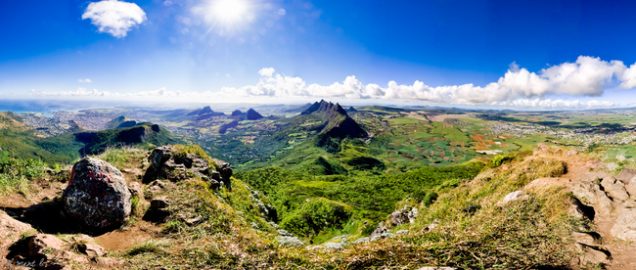
Mauritius is an island near Madagascar- off the coast of Africa. One of the other native species is a skink. Do you trust it to show you around?
Make friends with the skink.
Don’t trust him, he looks like trouble.

Slide 13
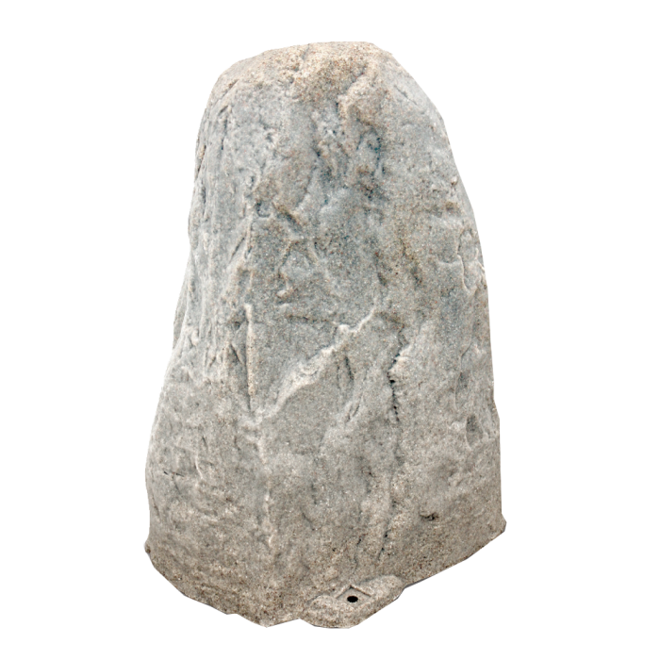
The Dodo has no natural enemies and a guide would have been helpful. That’s ok!
On your adventure, you also came across a rock that is 3 ft. tall- the same height as your Dodo! While he eats, your Dodo would like you to draw his portrait.
Draw your Dodo!
Tell them no no!

Slide 14
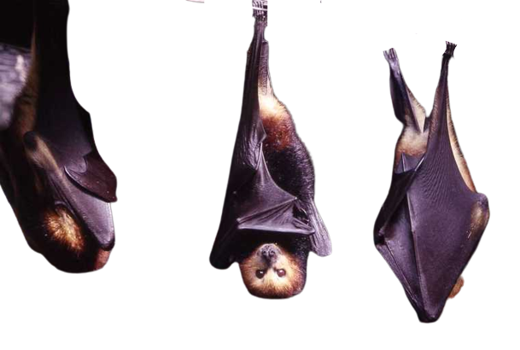
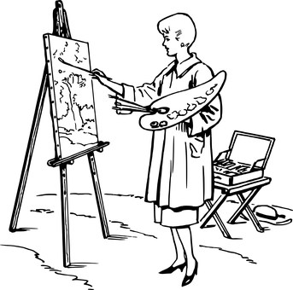
The Dodo bird has no natural enemies so you were right to trust the skink- he means no harm! In fact he invited his friends for a party! The Mauritian flying fox are also extinct species. The Dodo went extinct in 1660 where the flying fox went extinct around 1801.
Say goodnight and leave with only your memories.
Make a group portrait

Slide 15
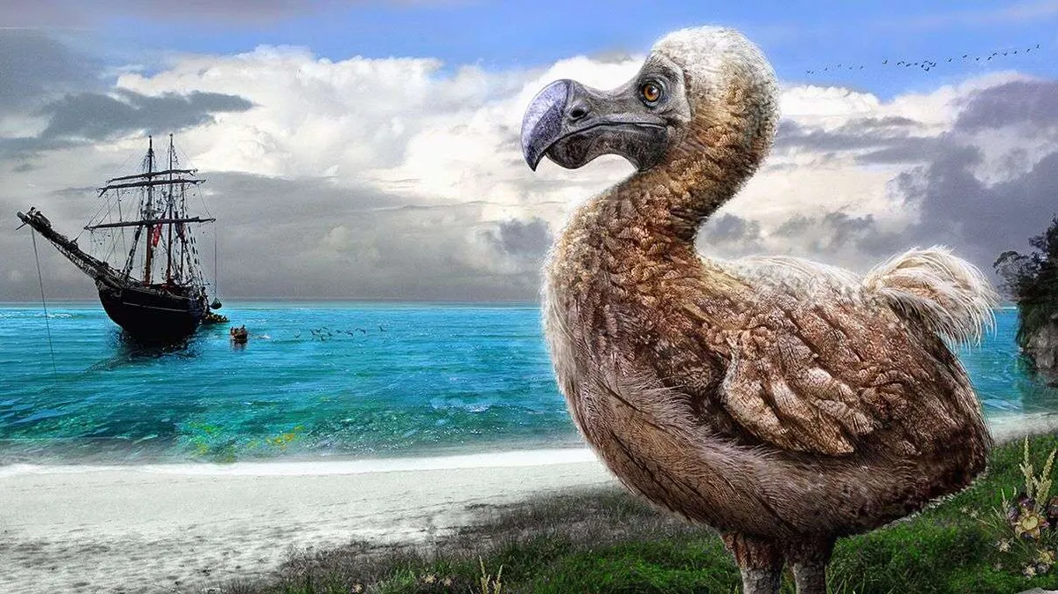
Sadly, the Dodo went extinct because sailors came to the island and ate them. Rumor is they didn’t even taste very good. It is sad to lose such a good friend.
Write and illustrate a story about your friend the Dodo.
Say farewell on your own.

Slide 16
History will have to learn about the Dodo from fossils and reading records from people who have visited Mauritius, their home island.
An archeologist with an example of a Dodo egg.
Click on the stack of books for more books featuring the Dodo!
Few complete skeletons exist of the Dodo
Dr Julian Hume's reconstruction of what Mauritius could have looked like in the time of the dodo © Julian Hume

Slide 17
Dodo is off to the Library to read more! Click on a book to put one on hold!
Click here to learn about other extinct creatures!

Slide 18
Your art will let your Dodo be remembered throughout history! Check out all the famous places your Dodo’s famous face has showed up!
A stamp from Mauritius, their home island!
Click on the stack of books for more books featuring the Dodo!
Muppets from Follow that Bird
The Mauritius Coat of Arms
The movie Ice Age showing off their
Taekwondo Skills
The 1951 movie Alice in Wonderland, inspired by Lewis Carroll’s book of the same title.

Slide 19
Dodo is off to the Library to read more! Click on a book to put one on hold!
Click here to learn about other extinct creatures!

Slide 20
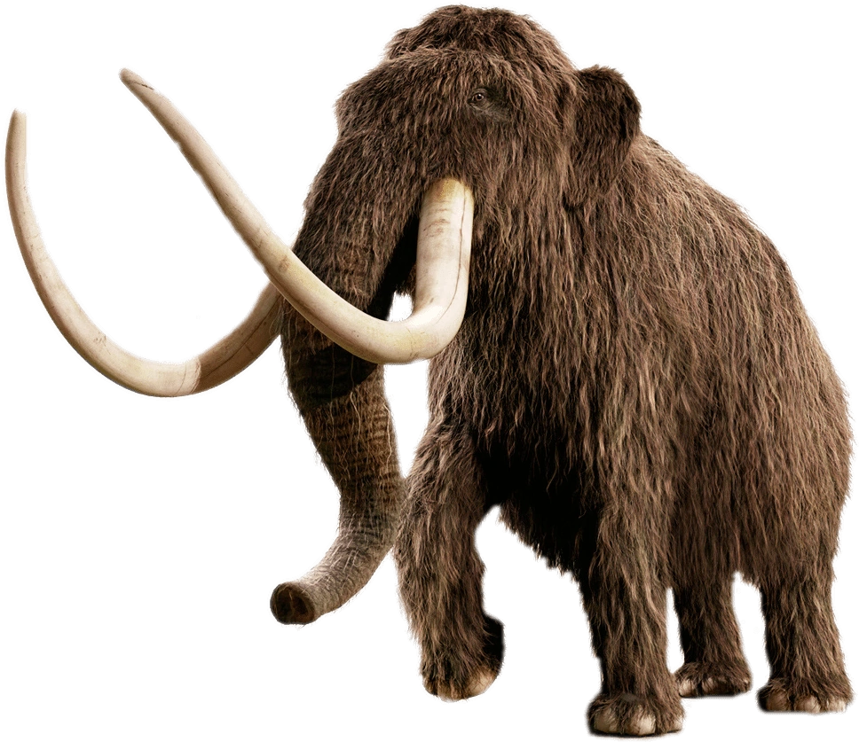
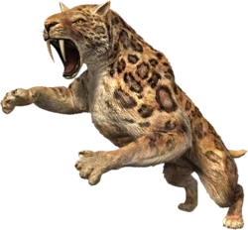
Lets learn more about other extinct creatures! Click on one for a list of books you can find at the library!
Woolly Mammoth
Sabre-toothed cat
Surprise me!

Slide 21
Fiction
OR
Non-Fiction

Slide 22
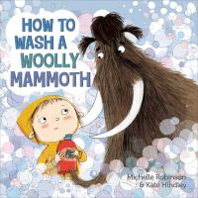
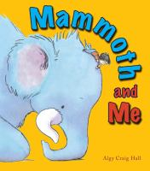
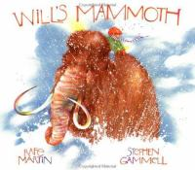
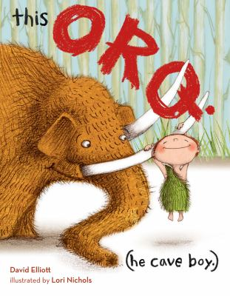
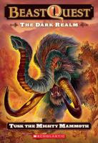
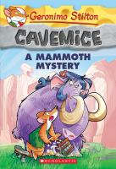
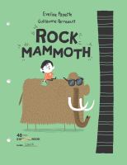
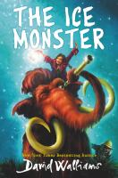
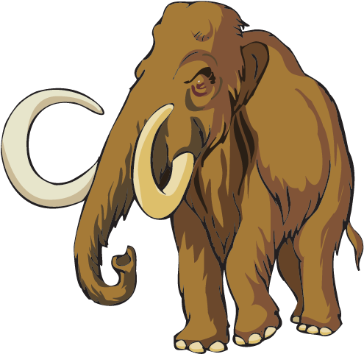
Click on a book to place a hold!
Fiction books about Mammoths to spark your imagination!

Slide 23
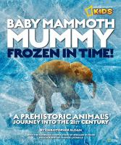
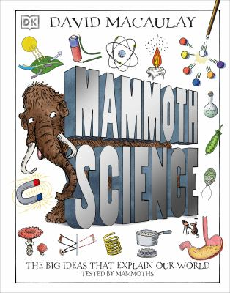
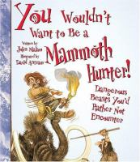
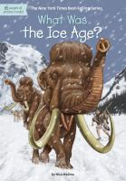
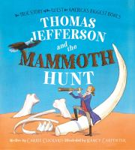
Click on a book to place a hold!
Non-fiction Mammoth Books to learn more!

Slide 24
Click on a book to place a hold!

Slide 25
Fiction
OR
Non-Fiction

Slide 26
Click on a book to place a hold!

Slide 27
Click on a book to place a hold!

Slide 28
Want to learn more? Check out these fun websites!
https://artsandculture.google.com/story/everything-you-ever-wanted-to-know-about-the-dodo/lQKCJWtqLgvEIA
https://animals.net/dodo/
https://www.amnh.org/explore/news-blogs/news-posts/mammoth-or-mastodon
https://www.youtube.com/watch?v=2NygtUEvY9k
https://kids.nationalgeographic.com/animals/prehistoric/facts/woolly-mammoth
https://www.britannica.com/animal/woolly-mammoth
https://www.exploringthedeep.com/creatures/megalodon/
https://naturalhistory.si.edu/education/teaching-resources/paleontology/extinction-over-time
https://www.worldwildlife.org/species/directory?direction=desc&sort=extinction_status
Or learn more on these TCCL databases
e-Library
Funk & Wagnalls New World Encyclopedia
Primary Search
Science Online

