Slide 1


Oklahoma Small Business Development Centers

Slide 2
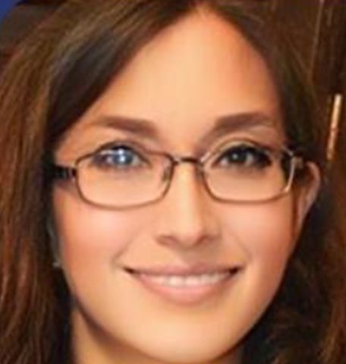


Maria F. Almeida​
Business Advisor​
Oklahoma Small Business Development Centers​
Tulsa Tech – Business and Industry Services​
3638 S Memorial Dr., Ste. 2208​
Tulsa, OK 74145​
(918) 960-0890​
maria.almeida@oksbdc.org

Slide 3
What We Do!
The SBDC provides confidential, high quality, no-cost entrepreneurial and small business management advising in order to help Oklahomans start and grow businesses. We are committed to helping grow Oklahoma’s economy one small business at a time.

Slide 4
Our Expertise!
Areas of Counseling
Accounting
Agribusiness
E-commerce
Financial Analysis
Government Contracting
Healthcare
Human Resources
International Trade
Marketing Research
Oil and Gas
Real Estate
Restaurants
Retail
Startups
SBA Lending
Tech Commercialization

Slide 5
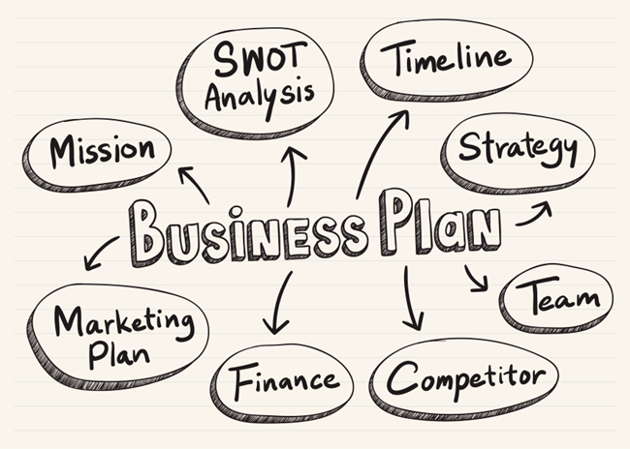








The Business Plan – The Next Step After Defining Your Business Model

Slide 6









The Business Model Canvas
Designed for:
Designed by:
Date:
Version:
Key Partners | Key Activities | Value Propositions |  | Customer Relationships | Customer Segments
 | Key Resources |  |  | Channels
Cost Structure |  |  | Revenue Streams
What are the most important activities your business needs to perform well?
What type of relationship is established and maintained with each Customer Segment?
How are customers acquired and retained?
Different groups of people you aim to reach and serve.
Profitable customers are the heart of any business model.
To best satisfy customers, you need to group them into segments based on common needs, problems, or behaviors.
To be successful make a conscious decision about which segments to serve and which segments to ignore.
Which customer segment is most important?
What problem(s) are you solving for your customers?
Why do customers turn to one company over another?
What makes your idea unique?
What are the different values you bring to your customers?
What makes your business different from your competitors?
What features and attributes could you add?
Who are the suppliers and partners that bring in external resources and activities.
How is the value proposition communicated and delivered to a Customer Segment (communication, distribution, and sales channels)?
How do you make your product or service reach your customers?
What are the most important assets required to offer and deliver the value proposition?
What costs will
be incurred
to operate
a business model?
What is the result of
a Value Proposition successfully offered to a Customer Segment?
For what value is each Customer Segment truly willing to pay?
Are the revenues transactional or recurring?
What costs will be incurred
to start the business?
This work is licensed under the Creative Commons Attribution-Share Alike 3.0 Unported License. To view a copy of this license, visit: http://creativecommons.org/licenses/by-sa/3.0/ or send a letter to Creative Commons, 171 Second Street, Suite 300, San Francisco, California, 94105, USA.
DesigneD by: Strategyzer AG
The makers of Business Model Generation and Strategyzer
strategyzer.com

Slide 7

WHAT LENDERS LOOK FOR IN A PLAN
YOU MAY NOT LIKE OR AGREE WITH HOW A LENDER EVALUATES A BUSINESS PLAN USED FOR A LOAN REQUEST, BUT THESE ARE THE RULES OF THE GAME.

Slide 8
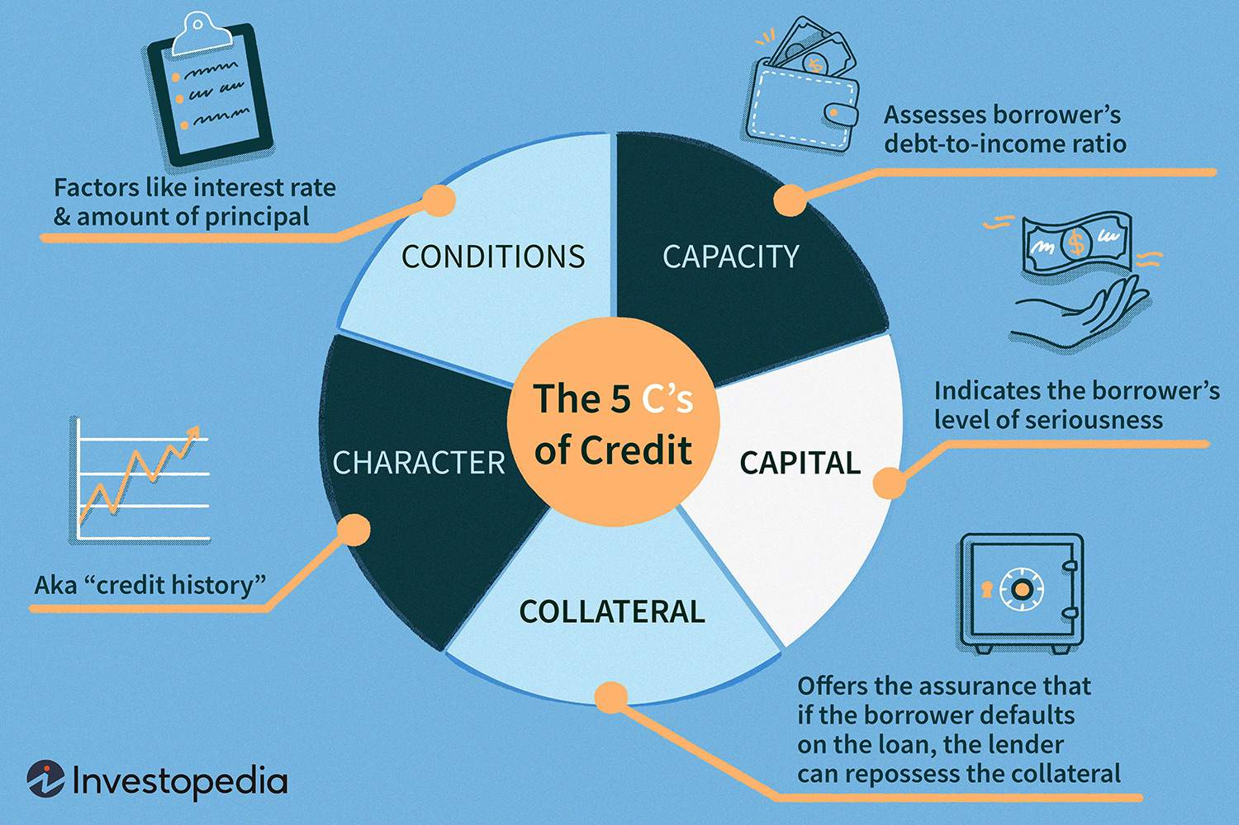
THE 5 C’S OF CREDIT

Slide 9
BUSINESS PLAN CHECKLIST
1. COVER SHEET
2. TABLE OF CONTENTS
3. EXECUTIVE SUMMARY
4. DESCRIPTION OF THE BUSINESS
5. MARKET ANALYSIS
6. OPERATING PLAN
7. MARKETING AND SALES PLAN
8. FINANCIAL PLAN
9. APPENDIXES

Slide 10

THE EXECUTIVE SUMMARY
It should be written last.
It is an overview (no more than one page long) of your business including the problem you think you aim to solve, why your solution is different, your ideal customer, and the expected results.
Include one or two reasons why this business will succeed.
This snapshot paragraph is particularly useful for a banker so that he or she knows the amount of the loan and can read the request in an appropriate context.

Slide 11

DESCRIPTION OF THE BUSINESS
OVERVIEW: a brief summary of your business, what it uniquely delivers, how you got started, your mission and goals, the management team, legal structure and ownership, and information about locations or facilities.
PRODUCT OR SERVICE DESCRIPTION: What problem are you trying to solve with your product or service?
OPPORTUNITY: How do you see the market for your solution with your product or service? What is the market and who are the participants?
PRICING: How much will you charge for your product/ service? What is your gross margin projection? Why your pricing will be attractive to your target market?

Slide 12

MARKET ANALYSIS
How well do you know your market and is big enough to support your business objectives?
Overview of the industry
Narrow down from the industry to your ideal customer
Target market characteristics
SWOT Analysis
Competition Analysis

Slide 13

OPERATING PLAN
How does your business work?
Management
Key employees and organization
Procedures to manufacture and
deliver products/ services
Payment methods and pricing plans
Technology
Key customers
Key suppliers
Facilities

Slide 14

MARKETING AND SALES PLAN
Promoting your business (generating leads, bringing traffic to your website, etc.) is one of the most important functions of any business.
Key messages (branding)
Marketing activities:
            Media advertising
            Direct mail
            Telephone
            Seminars/ conferences
            Joint advertising
            Word of mouth
            Digital marketing

Slide 15

FINANCIAL PLAN
Is where all the business plan comes together.
Sales forecast
Business expenses
Projected start-up budget: ongoing and one-time cost items that you need to open the business.
IMPORTANT: cushion for working capital
Projected cash flow: shows the expected amount of “cash” that will come into the business along with the money that will go out as expenses. I cannot be negative.
Projected profit and loss: shows the projected sales, cost of goods sold, gross profit, recurring expenses, and net income in a period of time (12 months).
Projected balance sheet: assets = liabilities + equity
DO NOT FORGET YOUR ASSUMPTIONS

Slide 16

Q&A

Slide 17
THANK YOU!
Maria F. Almeida​
Business Advisor​
Oklahoma Small Business Development Centers​
Tulsa Tech – Business and Industry Services​
3638 S Memorial Dr., Ste. 2208​
Tulsa, OK 74145​
(918) 960-0890​
maria.almeida@oksbdc.org

