Slide 1


Slide 2
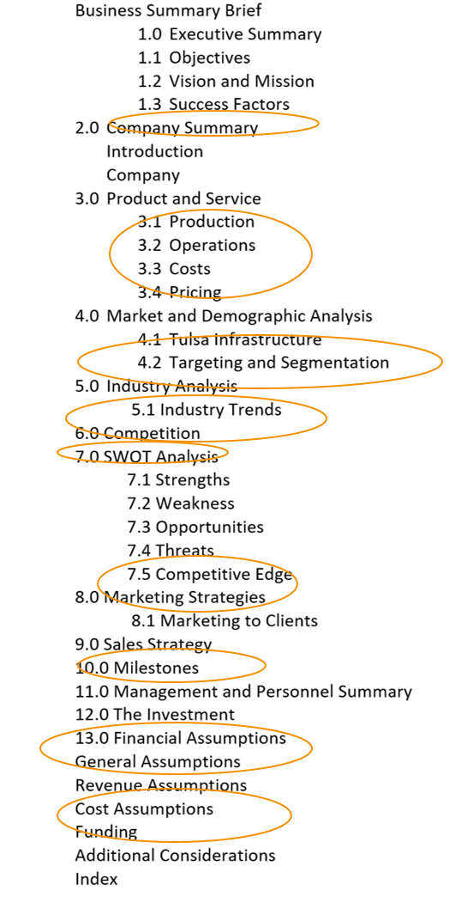


Business Plan

Slide 3



Slide 4

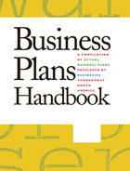
Actual business plans compiled by, and aimed at, entrepreneurs seeking funding for small businesses. Presents sample plans taken from businesses in the manufacturing, retail and service industries which serve as examples of how to approach, structure and compose business plans.

Slide 5

Business Plan Builder

Slide 6
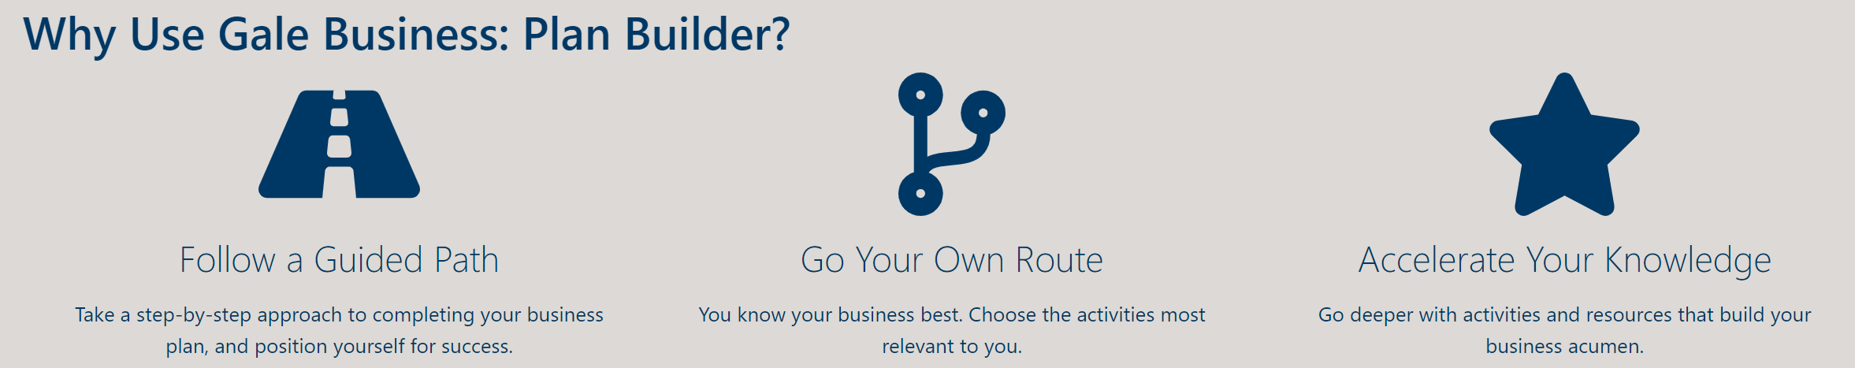
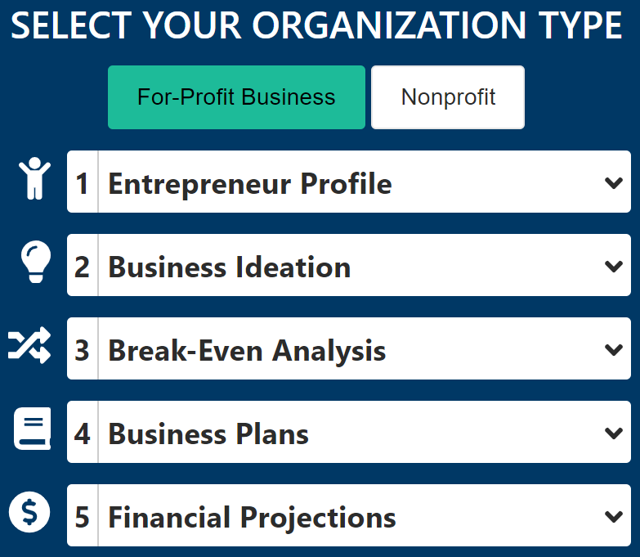
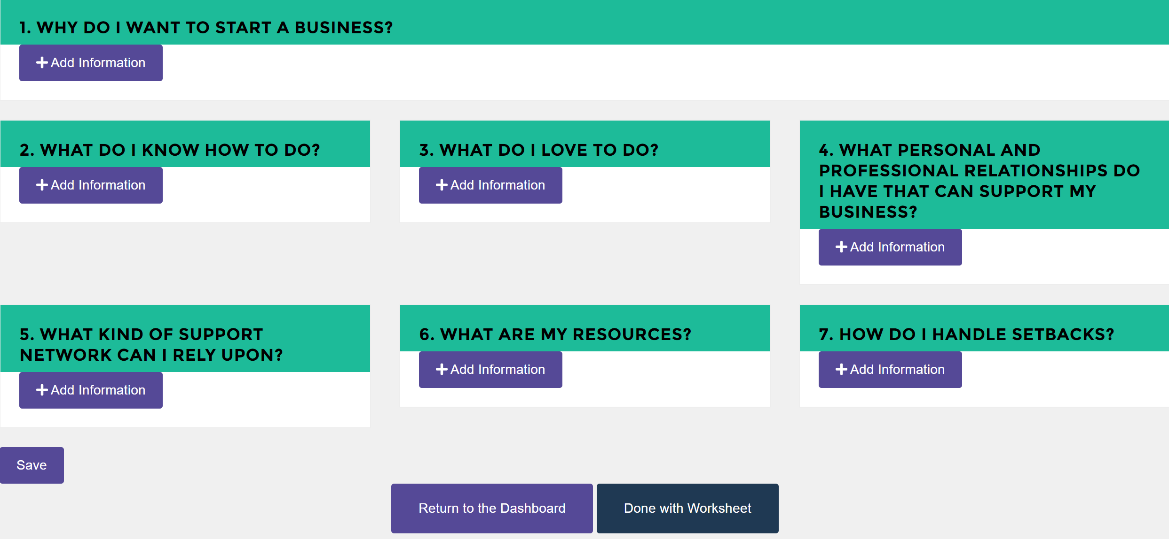

Slide 7

www.tulsalibrary.org/research

Slide 8
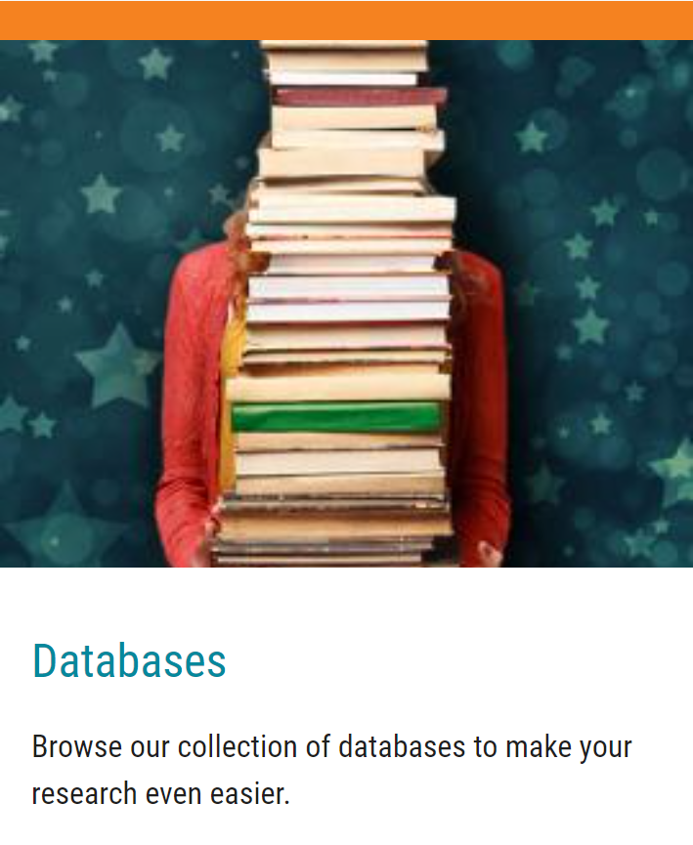
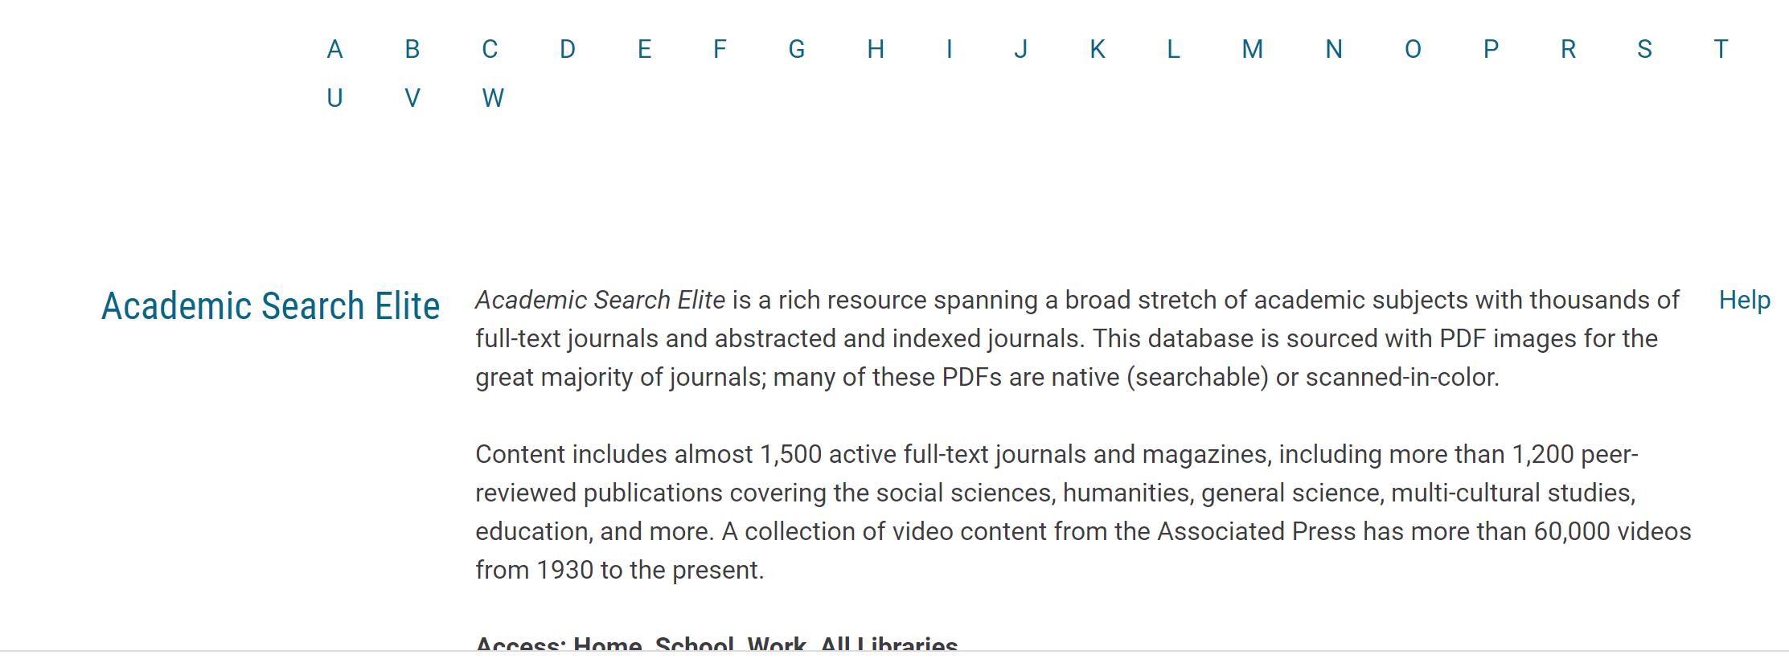

Slide 9
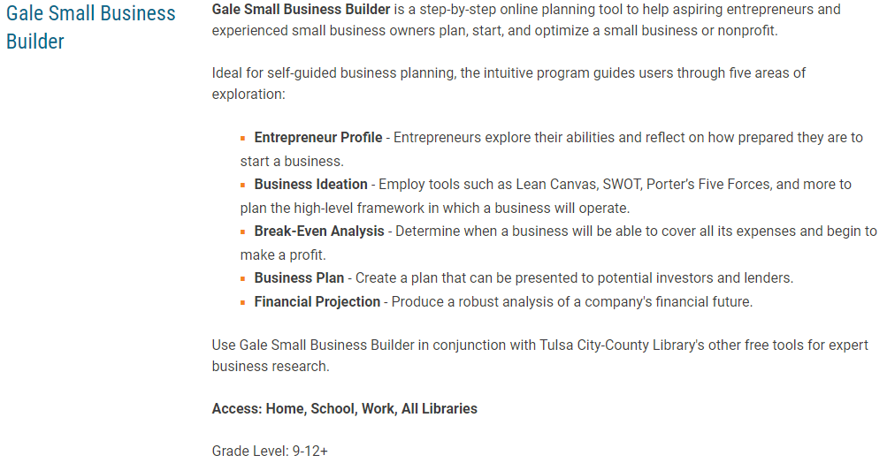

Slide 10
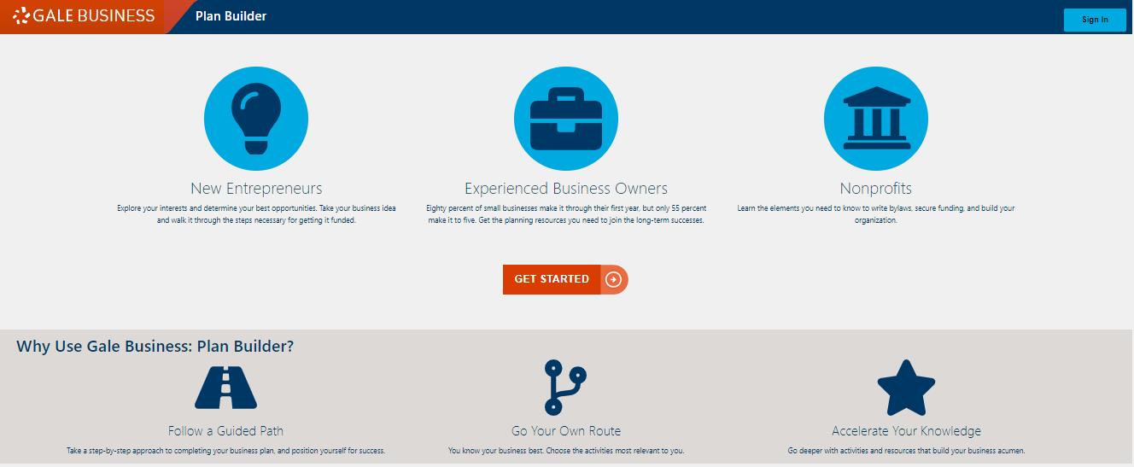

Slide 11
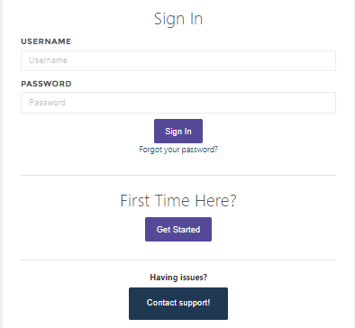
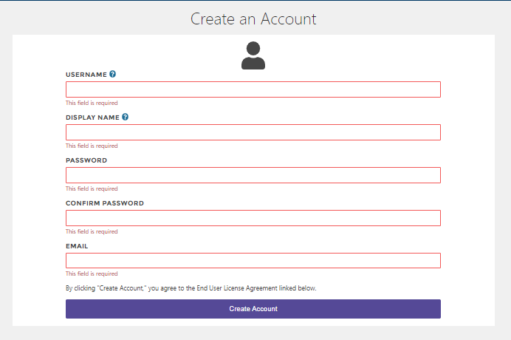

Slide 12
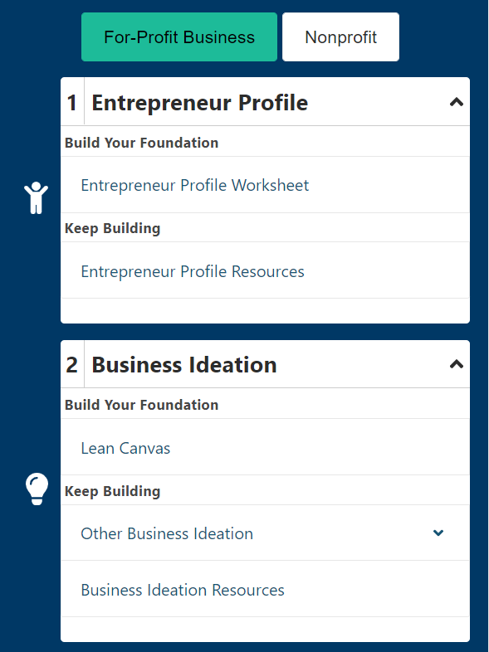
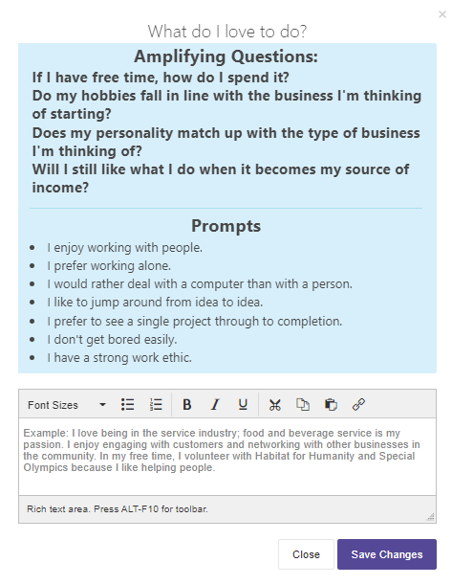
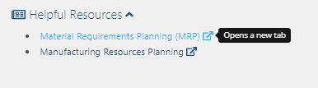
Select worksheets, and find prompts and guides to walk you through the process

Slide 13
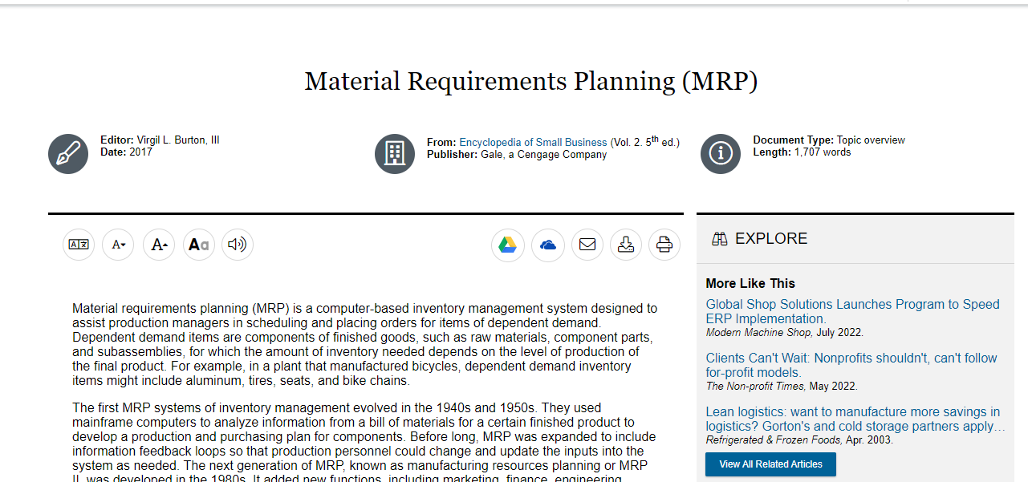

Slide 14
Entrepreneur Profile
Seven questions to help you describe yourself as an entrepreneur in a one page summary
Articles to further inform your profile: business ideas, entrepreneurship and innovation

Slide 15
Business Ideation
Lean canvas- a one page summary of your business idea
Canvas, SWOT, PEST, and Porter’s five forces
Ideation resources including articles to help you better understand the elements you will consider in your business plan

Slide 16
Break Even Analysis
Worksheets to help you calculate your costs
Articles on how to make these calculations
*The site says “give it your best guess”. We will learn how to retrieve this data throughout the course of this program. No need for guessing.

Slide 17
Business Plan
Brief business plan
Pitch deck samples
Sample plans
Marketing plans
Contingency plans

Slide 18
Financial Projections
Expenditures, debts and loans, equity, ect.
Resources for learning more about projections

Slide 19
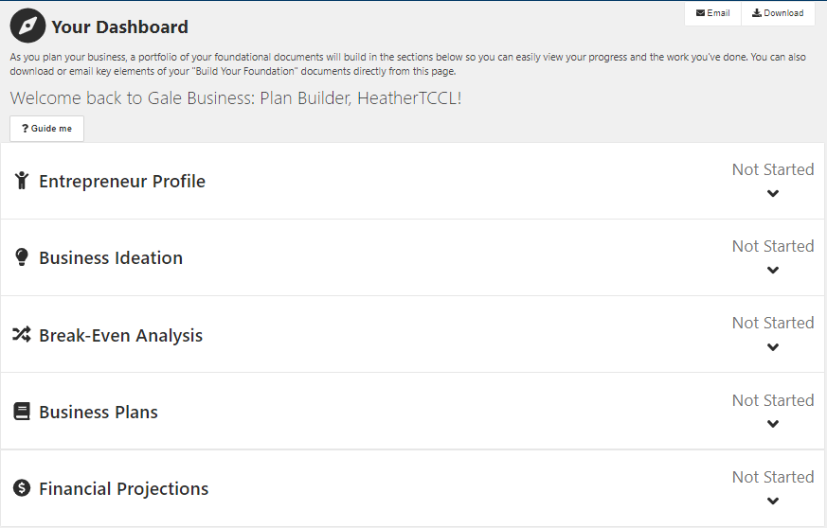

Slide 20
This is a good starting point, but not recommended
as the only source for business plans.

Slide 21


Slide 22

Questions?

Slide 23


Heather.Lozano@tulsalibrary.org
918-549-7429
wizard@tulsalibrary.org
918-549-7431
AskUs
918-549-7323

Slide 24
