Slide 1


Slide 2
You’re Worth It
Sales and Pricing

Slide 3

Market Oriented Pricing

Slide 4

Who spends on what you’re selling?
How much do they spend on products like yours in your service area?

Slide 5



Slide 6

Finding Consumer Expenditure
Comparison Reports

Slide 7
Select the Zip code of Your Business

Slide 8
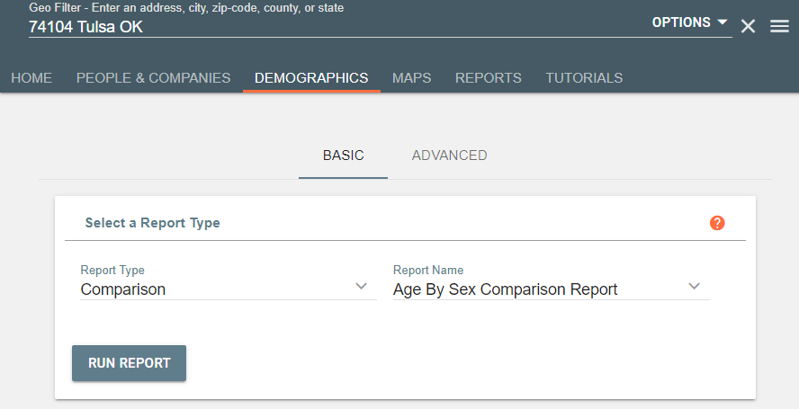
Select Demographics

Slide 9
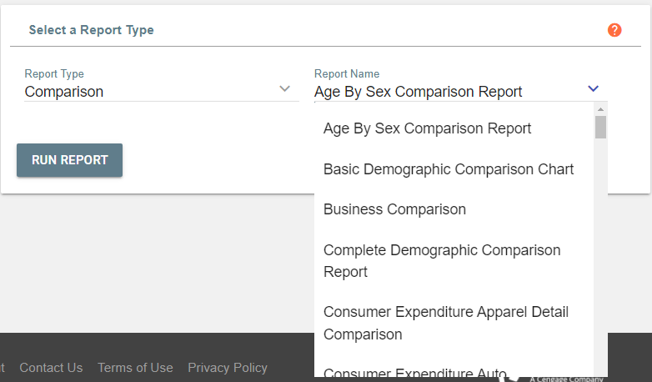
Select the Report You’d Like to Use

Slide 10
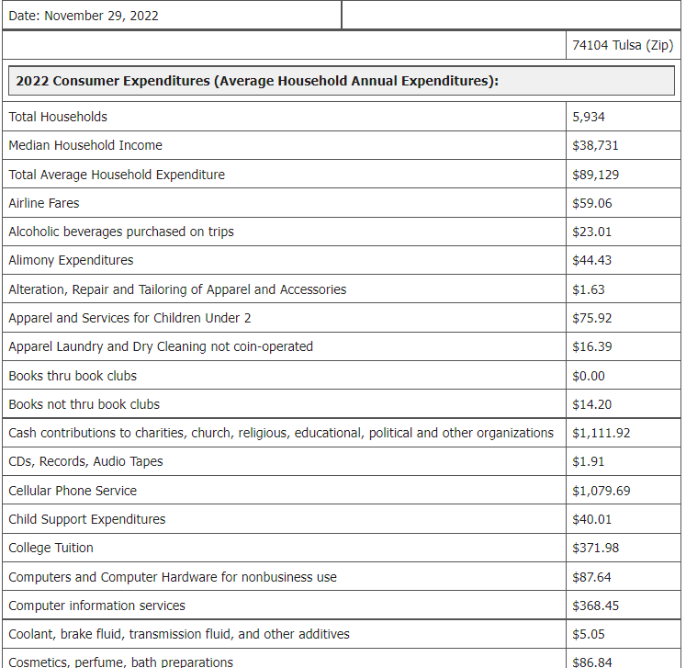
Run Report:

Slide 11


Slide 12
Finding Effective Buying Income and Projections

Slide 13
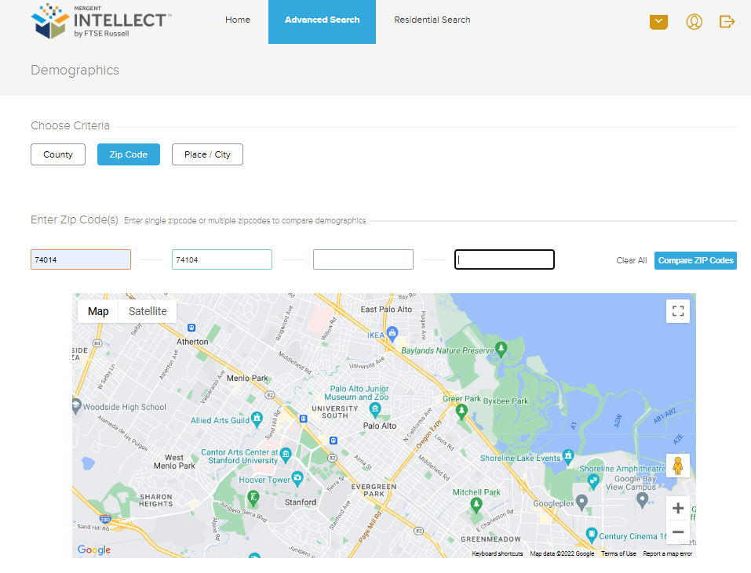
Set Zip Codes:

Slide 14
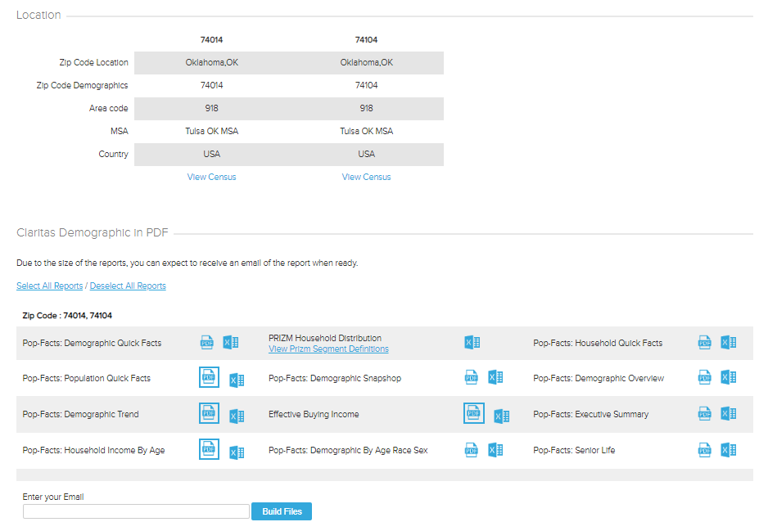
Select PDFs:

Slide 15
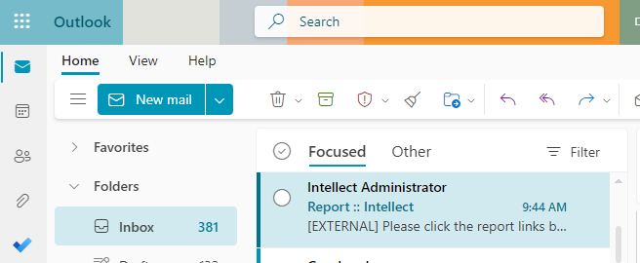
Check Your E-mail:

Slide 16
View Report:

Slide 17
Cost-Based Pricing

Slide 18
What is the overall operation cost for your industry?

Slide 20
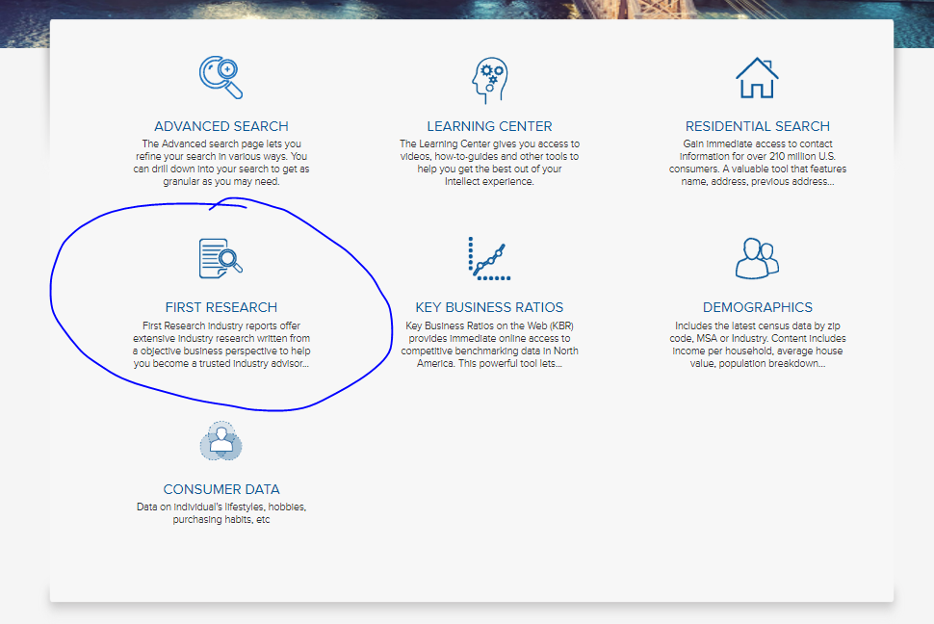

Slide 21
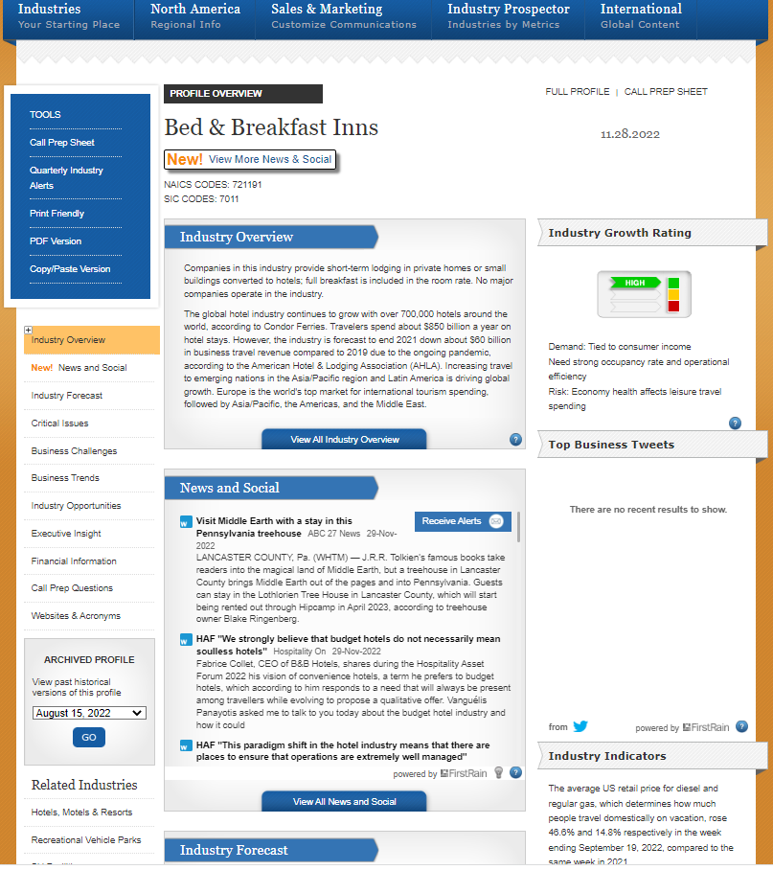
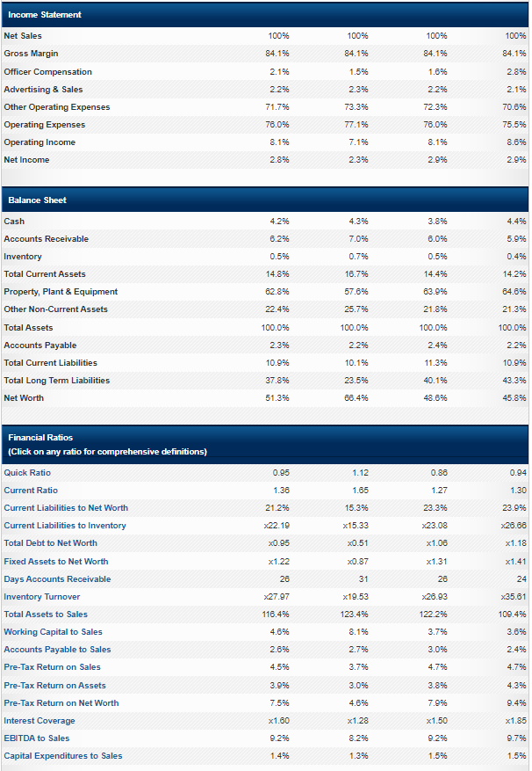

Slide 22


Slide 23
What You’ll Find Through a Bizminer Report

Slide 24

Questions?

Slide 25

AskUs
918-549-7323
askus@tulsalibrary.org

Slide 26

Heather.Lozano@tulsalibrary.org
918-549-7429
wizard@tulsalibrary.org
918-549-7431
AskUs
918-549-7323

Slide 28


