Slide 1
Jeff Moore, Executive Director

Slide 2
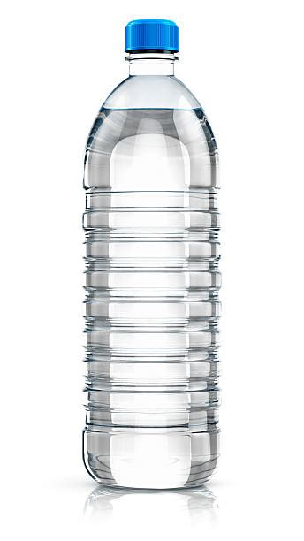
Pricing seems simple…
Walmart: $0.25.
Whole foods: $0.50.
Vending machine: $1
Bar: $2.
Hotel: $3
Airport: $5.
Bonaroo: $8
Taylor Swift Concert: $6,230

Slide 3
Introduction
What are your goals for today?
What pricing challenges do you face today?

Slide 4
Understanding pricing
Discuss pricing and its importance in business
Discuss the role of in pricing decisions in the innovation process

Slide 5
Understanding pricing starts with the source of your innovative design
Feasibility
Can we do it? What will it take?
Innovation
Desirability
Do people want it? Will they pay for it?
Viability
Is it financially feasible?
How do we get it to market?
Source: Change by Design, Tim Brown

Slide 6
Pricing is influenced by every step in the design thinking process
Pillars
Empathy
Ideation
Experimentation
Design element
Frame question
Gather inspiration
Generate ideas
Make ideas tangible
Test to learn
Share story
(and get it to market)
Tools
Issue trees
Market segmentation
Customer ecosystem
Empathy maps
Interviewing for insights
Brainstorming
Benchmarking
Hypothesis generation
Minimum viable products
Process mapping
Piloting and testing
Pyramid Principle
Source: IDEO.org, Design Thinking, The Lean Startup
Notes:
Empathy — Understanding the needs of those you’re designing for.
Ideation — Generating a lot of ideas. Brainstorming is one technique, but there are many others.
Experimentation — Testing those ideas with prototyping.
Frame question: Identify a driving question
Gather inspiration: Discover what people really need

Slide 7
To price appropriately, you need to know your target market…
Total Available Market
Served Available Market
Target Market

Slide 8
…and the influence of other stakeholders in the decision/buying process
Tool: Consider all players in the customer ecosystem
The
Saboteur
Influencer
You, LLC.
You, LLC.
User
User
Recommender
Super Duper
One of a Kind Product / Service
Decision
Maker
Payer

Slide 9
Tool: Empathy maps help build customer archetypes of behavior and environment
You have to know your customer archetype and what creates value
Source: Business Model Generation

Slide 10
You have to know your competitors
This slide can show the advantage of the product/service, but can also show its shortfalls in comparison with similar products
 | Metric derived from interview/ research | Metric derived from interview/ research | Metric derived from interview/ research | Metric derived from interview/ research
Product/ service
Competitor 2
Competitor 3
The metrics for comparison should represent the factors that make or break the purchase of the product

Slide 11
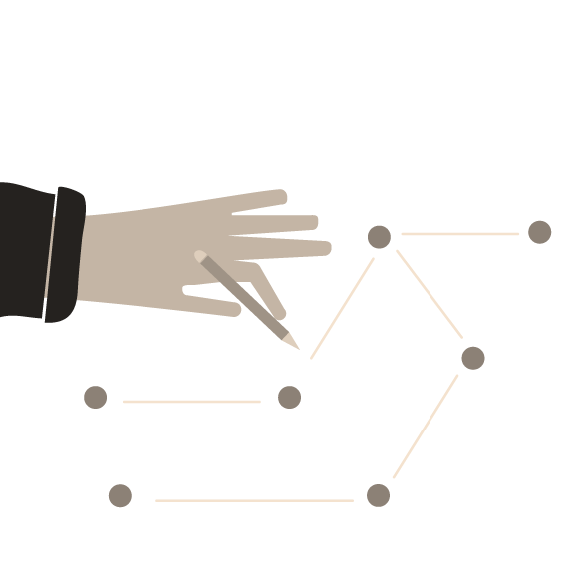
You have to know your product or service
Determining the Value Chain
How would it work?
How is the good, service, tech, delivered?
How does the money flow?
What partners are involved and how?
Notes:
First step, logistics
Make assumptions about the model that can be tested
Can also look like the customer journey

Slide 12
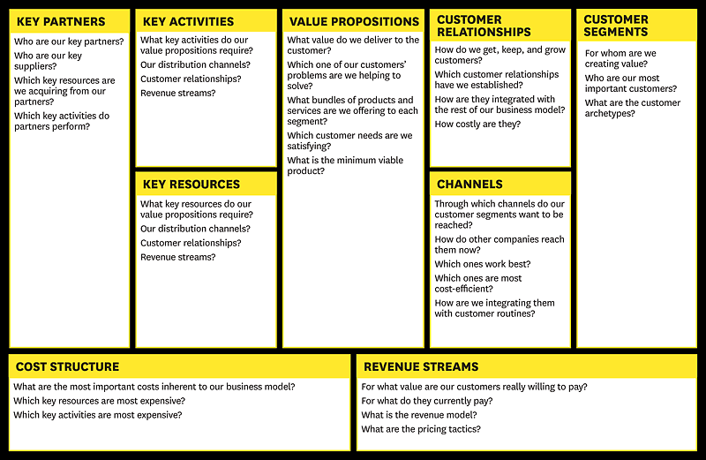
The business model canvas provides a frame to understand your offering
Harvard Business Review
Notes:
First step, logistics
Make assumptions about the model that can be tested
Can also look like the customer journey

Slide 13
You should know the details of how your product is delivered operationally….
Building 1
5
1
Check – in
2
Diagnostics
3
Doctor’s Evaluation
Pharmacy
4
Counseling
& X-ray
Cervical Care Room
Phase I: HPV
Phase II: See & Treat
10
1 practitioner working under doctor’s license
Vaccination training
200 vaccines/day
5 Swazi practitioners & 1 nurse
9 month training
300 screenings/day
Cervical Care
8
6
Minor Surgical
7
Pre/Post Operation
9
Wound Care
Eye Care
Building 2
Building 3

Slide 14
Division of flow
Bruker revenue FY17: $1766 M
Percentage in CALID group: $494.48 M
Bruker Optics share: $54.39M
Bruker revenue FY17: $1766 M
Percentage in CALID group: $494.48 M
Bruker Optics share (estimate 11% of market): $54.39 M
Manager estimate of food industry sales (20% of Bruker Optics market): $10.88 M
Estimate of DRIFTS sales (25%): $2.72 M
Estimate of DRIFTS machines sold per year (estimate $2000 per machine): 1350
Sell 50 Buttons @ $1.1 each per machine sold: $74.3K
6% royalty returned to OU: $4.5K
…And you should know the financial implications of the offering
Bruker customers in food industry: $10.88 M
DRIFTS machines sales: $6.528M
Exclusive license
Sells Buttons to transmission users
DRIFTS machines sold per year: 653
Manufacturing and sales
End users like academia
10 Buttons for $50 (1288% markup)
Sell 50 Buttons @$1.1 each per machine sold: $35.86K
$10K licensing fee +
6% royalty on revenue
6% royalty returned to OU: $1.79K
Pre-licensing requirements
Best fit manufacturers
Accreditation requirements
Manager estimate of food industry sales (20%)
File full utility patent application
Manufacturers may apply for ASTM and ANSI requirements
Estimate 60% of customers purchase DRIFTS
Estimate 11% of market
Complete accuracy and precision tests
Fit criteria
End users re-verify the device
Estimate $10k cost per machine
Must control a portion of the sampling prep market
Bruker revenue FY17: $1766 M
Percentage in CALID group: $494.48 M
Experience licensing and developing with universities
Notes:
Nonexclusive license: chosen to maximize profit

Slide 15
You should know the type of revenue source
Common revenue stream types
Asset sale
Know your customer segment:
How does this customer segment typically buy?
Who are the intermediaries (distributors, insurance companies)?
What are the associated distribution costs?
What will benefit your business (amount vs timing)?
Usage fee
Subscription
Lend/ rent/ lease
Licensing
Brokerage
Advertising
Grants
Notes:
Asset sale: sale of physical product
Usage fee: Fee of one time service
Subscription: Sell continuous service
Lease: exclusive right to use a particular asset for a fixed period
License: fee for use of IP
Brokerage: intermediation fee
Advertising: well, advertising

Slide 16
…Before you using three types of pricing methods
Cost plus
Know baseline profitability for negotiating with distributors, bulk orders, etc.
Competitive basis
Understand what customers currently are willing to pay for similar product/ service
Value add
Calculate benefit gained by a customer from using your product/ service

Slide 17
Those methods could be optimized with a different strategy…
Specific strategies to optimize your return
Market-based pricing
Psychological pricing
Dynamic pricing
Premium pricing
Penetration pricing
Examples
a small business that sells handmade products may adjust its pricing based on the price range of similar products sold by competitors at local craft fairs.
a retailer may price a product at $9.99 instead of $10.00 to make it seem like a better value to customers.
an airline may adjust ticket prices based on demand, with higher prices during peak travel times and lower prices during slower periods.
a high-end jewelry brand may set a high price for its diamond necklaces to convey their exceptional quality and craftsmanship.
For example, a new smartphone manufacturer may set a low price to gain market share and attract customers away from established competitors.

Slide 18
..and pricing tactics could be selected to further maximize profits
Tactics
Examples
Bundling and unbundling
Discounting
Price skimming
Price lining
Price anchoring
Price discrimination
a software company may bundle several products together to offer customers a discount, or unbundle features from a premium product to create a more affordable version.
a clothing retailer may offer a 20% discount during a holiday sale to incentivize customers to make purchases.
a technology company may introduce a new product at a high price and gradually lower the price as competitors enter the market.
offering a range of car models at different price points, such as an economy line, a mid-range line, and a luxury line.
A restaurant displaying an expensive, high-end dish on the menu to make other menu items seem like a better value.
A movie theater offering discounted tickets for seniors or students

Slide 19
Testing your pricing plan can vary from more research to real world tests
Testing strategies to get your plan…
Conduct surveys
Price Sensitivity Meter (PSM)
Price Rating Scales
Gabor Granger pricing studies
Conjoint analysis
A/B testing
Market research
Trial and error
"Everybody has a plan until they get punched in the mouth“
-Mike Tyson

Slide 20
Common pricing mistakes to avoid
Underpricing or overpricing
Failing to consider the competition
Failing to consider the value proposition
Failing to adjust prices over time
Failing to communicate pricing decisions effectively

Slide 21
Conclusion
Pricing requires deep knowledge of your product, market, the target customers, the broader ecosystem, and the competition
There is no silver bullet to choose the best price, the market will tell you
There are many pricing tactics you could use to optimize your return

Slide 22
References for more learning
Books:
"Priceless: The Myth of Fair Value (and How to Take Advantage of It)" by William Poundstone
"The Strategy and Tactics of Pricing: A Guide to Profitable Decision Making" by Thomas Nagle and John Hogan
"Value-Based Pricing: Drive Sales and Boost Your Bottom Line by Creating, Communicating and Capturing Customer Value" by Harry Macdivitt and Mike Wilkinson
"Pricing for Profit: How to Develop a Powerful Pricing Strategy for Your Business" by Peter Hill
Online resources:
Harvard Business Review - "The Right Way to Manage Unprofitable Customers" by Andreas Hinterhuber and Stephan Liozu
McKinsey & Company - "The Power of Pricing" by Georg Winkler, Scott Keller, and Jim Lattin
Forbes - "The Top 6 Pricing Strategies for Small Businesses" by Hootan Shahidi

