Slide 1
Oklahoma Small Business Development Centers

Slide 2
Jessee Paxton
Business Advisor​
Oklahoma Small Business Development Center
Greenwood Women’s Business Center
102 N. Greenwood Avenue
2nd Floor – Room 204, Tulsa, OK 74120
(918) 376-0433
Jessee.Paxton@oksbdc.org

Slide 3
What We Do!
The SBDC provides confidential, high quality, no-cost entrepreneurial and small business management advising in order to help Oklahomans start and grow businesses. We are committed to helping grow Oklahoma’s economy one small business at a time.

Slide 4
Our Expertise!
Areas of Counseling
Accounting
Agribusiness
E-commerce
Financial Analysis
Government Contracting
Healthcare
Human Resources
International Trade
Marketing Research
Oil and Gas
Real Estate
Restaurants
Retail
Startups
SBA Lending
Tech Commercialization

Slide 5
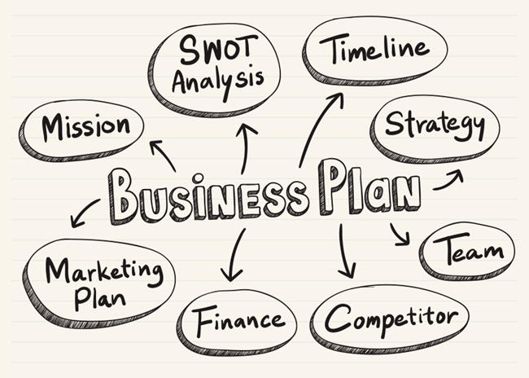
The Business Plan – The Next Step After Defining Your Business Model

Slide 6
WHAT LENDERS LOOK FOR IN A PLAN
YOU MAY NOT LIKE OR AGREE WITH HOW A LENDER EVALUATES A BUSINESS PLAN USED FOR A LOAN REQUEST, BUT THESE ARE THE RULES OF THE GAME.

Slide 7
Business Plan Questions
1. Who are all the people involved in my business?
2. What do you do?
3. What do your customers “look like’?

Slide 8
Business Plan Questions Continue…
4. Why would customers buy from you?
5. How are going to do what you do?
6. How are you going to get word out?

Slide 9
Business Plan Questions Continue…
7. Who are your top three competitors
8. What could go wrong
9. What are your top three goals for the next six months

Slide 10
BUSINESS PLAN CHECKLIST
1. COVER SHEET
2. TABLE OF CONTENTS
3. EXECUTIVE SUMMARY
4. DESCRIPTION OF THE BUSINESS
5. MARKET ANALYSIS
6. OPERATING PLAN
7. MARKETING AND SALES PLAN
8. FINANCIAL PLAN
9. APPENDIXES

Slide 11
THE EXECUTIVE SUMMARY
It should be written last.
It is an overview (no more than one page long) of your business including the problem you think you aim to solve, why your solution is different, your ideal customer, and the expected results.
Include one or two reasons why this business will succeed.
This snapshot paragraph is particularly useful for a banker so that he or she knows the amount of the loan and can read the request in an appropriate context.

Slide 12
DESCRIPTION OF THE BUSINESS
OVERVIEW: a brief summary of your business, what it uniquely delivers, how you got started, your mission and goals, the management team, legal structure and ownership, and information about locations or facilities.
PRODUCT OR SERVICE DESCRIPTION: What problem are you trying to solve with your product or service?
OPPORTUNITY: How do you see the market for your solution with your product or service? What is the market and who are the participants?
PRICING: How much will you charge for your product/ service? What is your gross margin projection? Why your pricing will be attractive to your target market?

Slide 13
MARKET ANALYSIS
How well do you know your market and is big enough to support your business objectives?
Overview of the industry
Narrow down from the industry to your ideal customer
Target market characteristics
SWOT Analysis
Competition Analysis

Slide 14
OPERATING PLAN
How does your business work?
Management
Key employees and organization
Procedures to manufacture and
deliver products/ services
Payment methods and pricing plans
Technology
Key customers
Key suppliers
Facilities

Slide 15
MARKETING AND SALES PLAN
Promoting your business (generating leads, bringing traffic to your website, etc.) is one of the most important functions of any business.
Key messages (branding)
Marketing activities:
Media advertising
Direct mail
Telephone
Seminars/ conferences
Joint advertising
Word of mouth
Digital marketing

Slide 16
FINANCIAL PLAN
Is where all the business plan comes together.
Sales forecast
Business expenses
Projected start-up budget: ongoing and one-time cost items that you need to open the business.
IMPORTANT: cushion for working capital
Projected cash flow: shows the expected amount of “cash” that will come into the business along with the money that will go out as expenses. I cannot be negative.
Projected profit and loss: shows the projected sales, cost of goods sold, gross profit, recurring expenses, and net income in a period of time (12 months).
Projected balance sheet: assets = liabilities + equity
DO NOT FORGET YOUR ASSUMPTIONS

Slide 17
Q&A

Slide 18
THANK YOU!
Jessee Paxton
Business Advisor​
Oklahoma Small Business Development Center
Greenwood Women’s Business Center
102 N. Greenwood Avenue
2nd Floor – Room 204, Tulsa, OK 74120
(918) 376-0433
Jessee.Paxton@oksbdc.org

