Slide 2
Tulsa City County Library Grow Academy
Networking and Mentoring
J. Miller Law Firm, P.L.L.C.
November 19th, 2022

Slide 3
Background
Business owner since 2014.
85% of current business coming through networking/referrals/community involvement.
SCORE – Mentor and Subject Matter Expert
Consultant – Oklahoma Small Business Continuity Program
Mentor – Oklahoma Entrepreneur Mentoring Program
2022 Board Chair – Bixby Chamber
2022 Entrepreneur of the Year
2020 Woman Owned Business of the Year
2020-2022 Closed Networking Group Leader

Slide 4
Networking
What does it mean to you?
Transactional vs. Relationship Networking

Slide 5
Networking Sources
Open Groups
Closed Groups (Leads/Referral Groups)
Social Media Groups
Community/Civic Engagement
Industry-Specific Groups

Slide 6
“Elevator Speech”
What do you do?
Focus on what you do.
What makes you/your business unique?
What’s a good referral for you?

Slide 7
Game Plan for Networking
Figure out a way to make the relationship mutually beneficial. If you are always asking your contact for something and never giving, they will stop answering.
If you are trying to sell something, don’t make every contact about trying to do a deal. Send them an article you think they would like. Invite them to a social function where you do things other than just talk business. Find out what their real interests in life are and do something to support those interests.
When you find someone you honestly like, work to make them a friend.
Develop a manageable target list of contacts that would mean the most to your business, and work to develop authentic relationships with those people.

Slide 8
Game Plan, cont.
Find the right events, functions, and networking events where the people you want to be around attend. And have a game plan for what you want to accomplish at the function (# of people to meet, specific people to meet, etc.).
Be sure you are the one to follow up, and determine where you want to take the relationship.
Use social media the right way. There is no right way to use social media except to use it. LinkedIn is the best we have for business social networking. You can find information you want on people, determine common contacts, get to know someone a bit more, etc.
Source: https://www.score.org/blog/networking-success

Slide 9
Networking Scenarios
Example 1
The hard close/transactional networking.
Example 2
Listen more than talk.

Slide 10
Networking Etiquette
Social Media
Don’t add people to your email newsletter, etc. without asking.
Avoid getting too personal or controversial.

Slide 11
Follow-Up
Post-Event
Thank you – email, call, card?
Giving and Receiving Referrals
The mutual email introduction.
Keeping Track – CRM

Slide 12
Putting It in Practice
Networking Bingo
Rules:
Find someone who matches the description in the box and have them initial that box.
You can only sign a paper once. Ex: If Bill signs Sally's paper, Bill cannot sign Sally's paper again in a different box.
To Win: Must have 5 initials in a row.

Slide 13
Mentors
Researchers found that 92% of small-business owners felt mentors directly impacted whether their companies thrived. However, a mere 22% actually had advisers when they first started.
Source: https://www.score.org/blog/benefits-finding-and-using-business-mentor#:~:text=Researchers%20found%20that%2092%25%20of,difference%20between%20success%20and%20failure.
Mentors vs. Business Coach

Slide 14
Purpose
Open new opportunities/connections.
Avoid common pitfalls.
Develop new skills.
Have a sounding board.

Slide 15
Mentors and Startups
Mentor quality matters.
If you want your company to be among the best, you need a mentor who knows how to reach that level.
Good mentorship requires a sustained relationship.
Ongoing/scheduled meetings/conversations.
Great mentors focus on critical business issues.
Focus on discussions of major issues that you are facing in business.
The best mentors are very busy individuals.
Source: https://techcrunch.com/2015/03/22/mentors-are-the-secret-weapons-of-successful-startups/

Slide 16
Questions to Ask a Mentor
What unique situations have they found themselves in that generated a change or adaptation in the way they run their business?
What are my areas of weakness?
How are you currently increasing business growth?
How are our finances looking?
If you could improve my mission statement, what would you change?
What should I do about a particular employee situation?

Slide 17
Advice From Mentors
Own your mistakes.
Focus on what you want – not what you think you should be.
Embrace the uncomfortable.
Take time for yourself.
Hire trustworthy people.
Stay quiet when asking questions.
Source: https://www.score.org/blog/14-entrepreneurs-share-best-advice-they%E2%80%99ve-ever-received-mentor

Slide 18
Putting It All Together
Build and strengthen relationships.
Create a network of partners you can refer as well.
Name/Brand Recognition
Sounding board for tough decisions and accountability.
Increase your sales.
Improve your closing rate.

Slide 19
Contact Info
918-938-1322 (Office phone, does not receive texts.)
jamie@jmillerlawfirmpllc.com
Social Media
Linkedin.com/in/jmillerlawfirm
Facebook.com/jmillerlawfirm
IG: jmlaw2022
Twitter: @JMillerLawFirm

Slide 21
Business Plan
Guides on the Entrepreneurial Expedition
Networking and Mentors

Slide 22
Small Business Reference Center
Business Source Elite
Access Business News

Slide 23
Small Business Reference Center

Slide 24
Industry information by business type
NOLO
Articles from experts searchable by topic

Slide 25
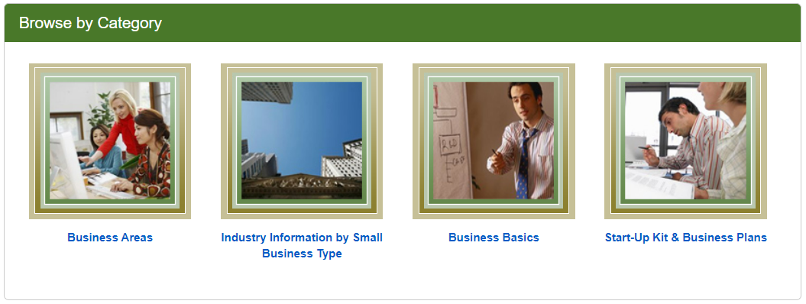
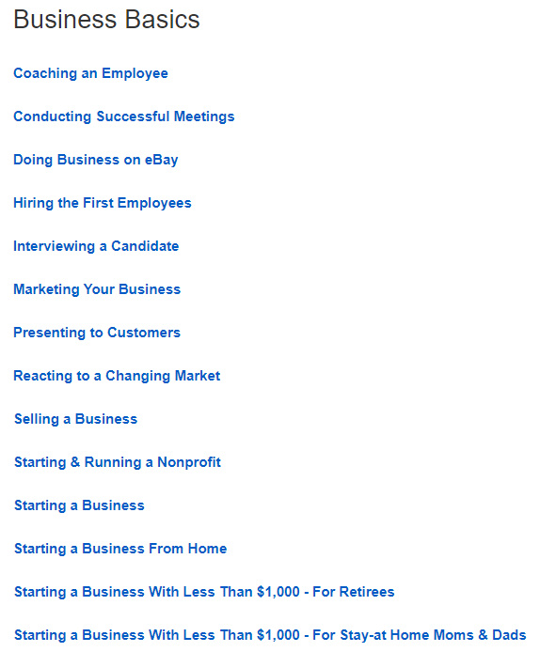
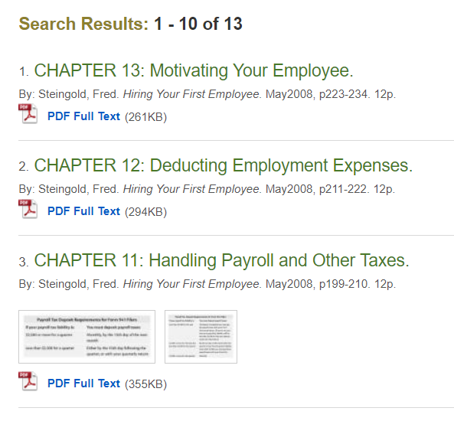
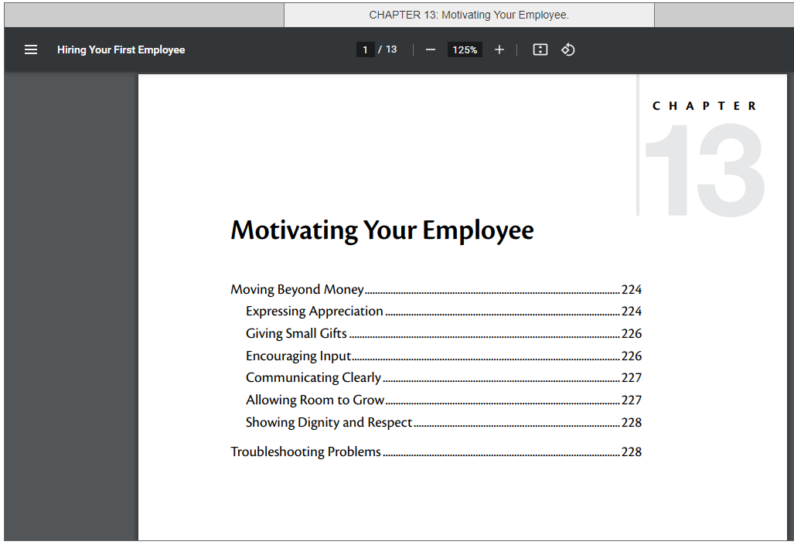

Slide 26
NOLO
Advice from legal experts
E-books are available on this database and won’t count against your borrowing limit.

Slide 27
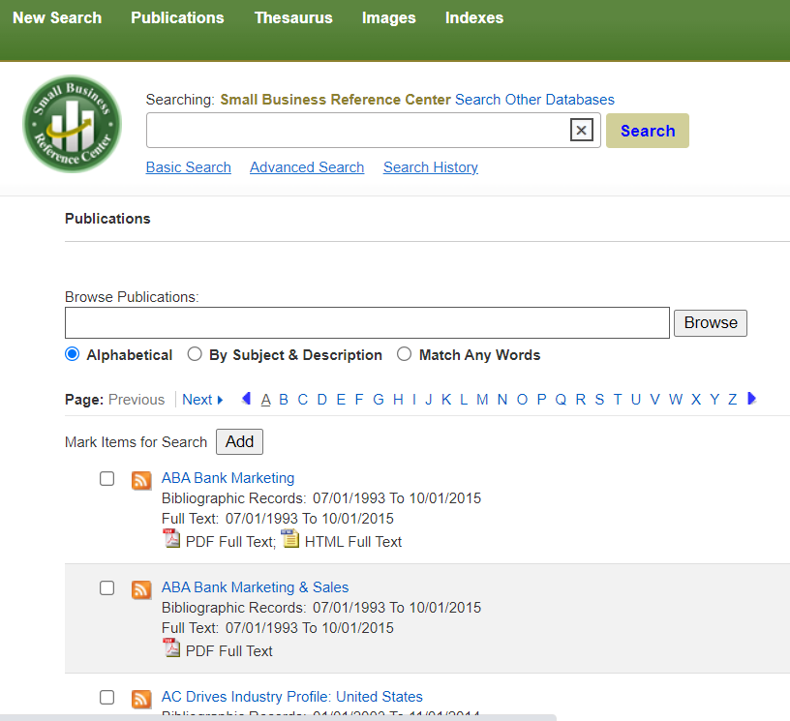
Search by Publication

Slide 28
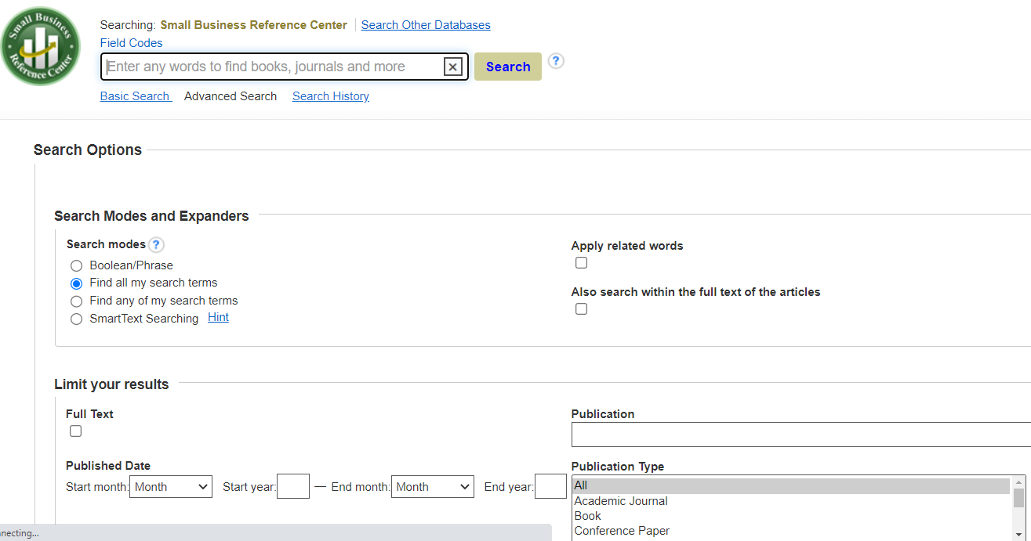
Advance Search

Slide 29
Advance Search

Slide 30
Advance Search
Research 101

Slide 31
Boolean Phrases
Boolean searches allow you to combine words and phrases using the words AND, OR, NOT (known as Boolean operators) to limit, broaden, or define your search. A good researcher should know how to do a Boolean Search.- New York Public Library

Slide 32
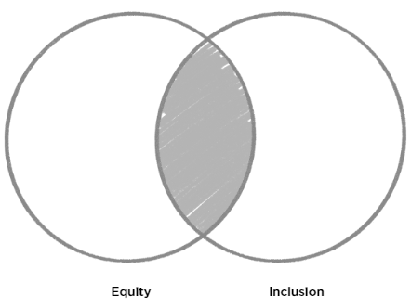
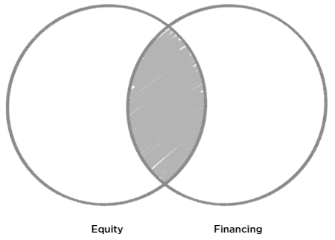
And
AND : Using AND narrows a search by combining terms.

Slide 33
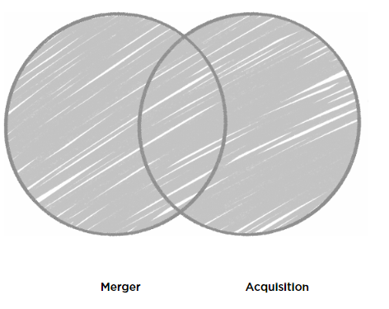
OR
OR : Using OR broadens a search to include results that contain either of the words you're looking for.

Slide 34
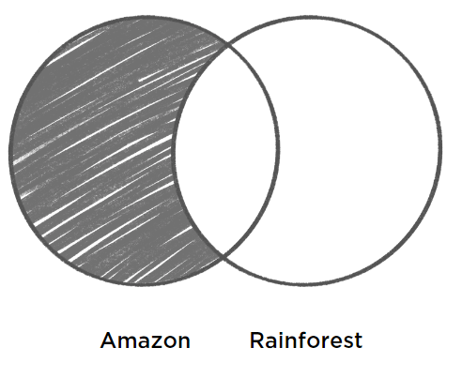
Not
NOT : Using NOT will narrow a search by exclusion. (Some search engines, like Google, recognize the minus (-) symbol, instead of the word NOT).

Slide 35
Quotations
“Enterprise Rent a Car”

Slide 36
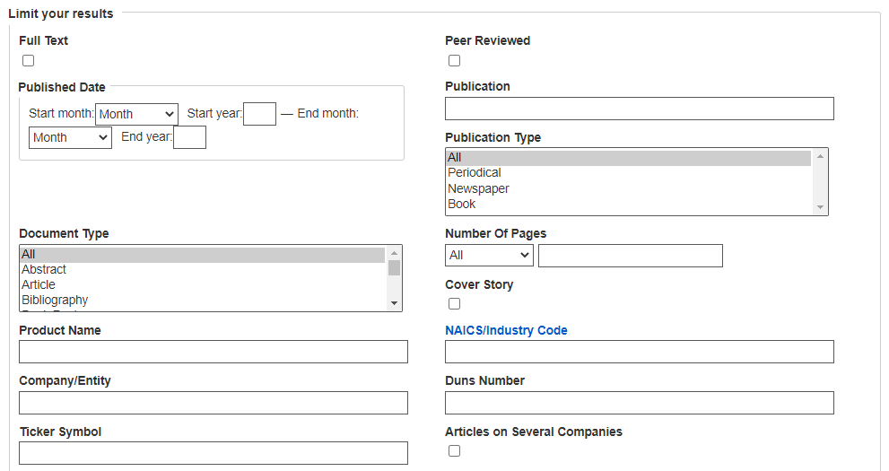

Slide 37
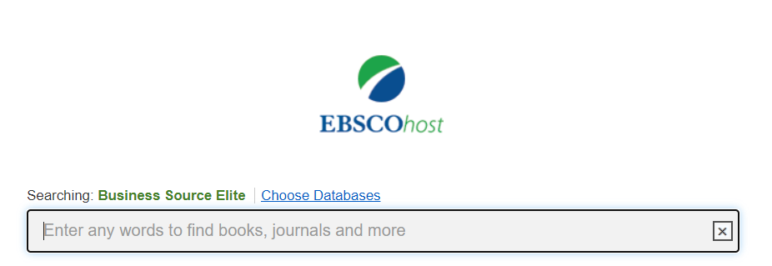
Look for specific publications
Search by topic
Find Market Line reports (company profiles)

Slide 38
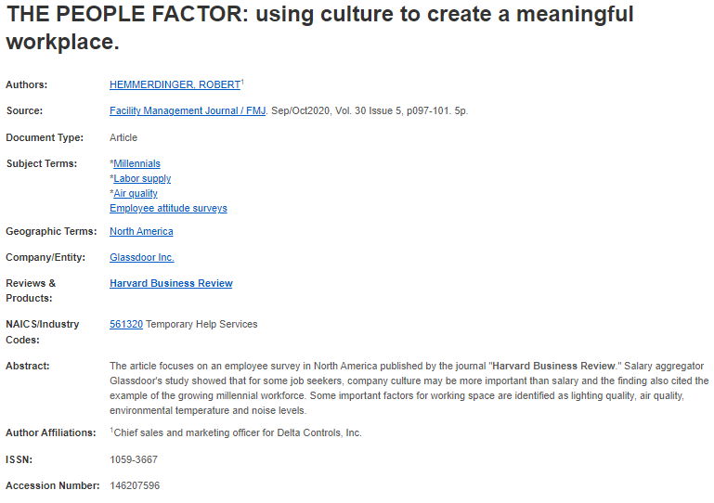
Find more information by utilizing the linked search terms

Slide 39
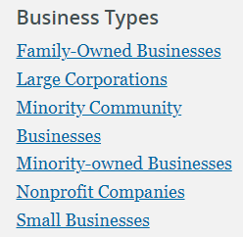
Browse by topic or use Booleans to search for specific information
Find information from a global perspective
Get information about/by business leaders
Search by blog, journal, newspaper, transcripts or videos

Slide 40
AskUs
918-549-7323
askus@tulsalibrary.org

Slide 41
Questions?

Slide 42
Heather.Lozano@tulsalibrary.org
918-549-7429
wizard@tulsalibrary.org
918-549-7431
AskUs
918-549-7323

Slide 43
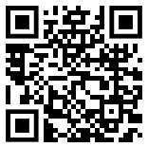
Thank you!
Please fill out this survey.

