Slide 2
You’re Worth It
Sales and Pricing

Slide 3
Market Oriented Pricing

Slide 4
Where is the best zip code for your business?
Who spends on what you’re selling?

Slide 6
Finding Consumer Expenditure
Comparison Reports

Slide 7
Select the Zip code of Your Business

Slide 8
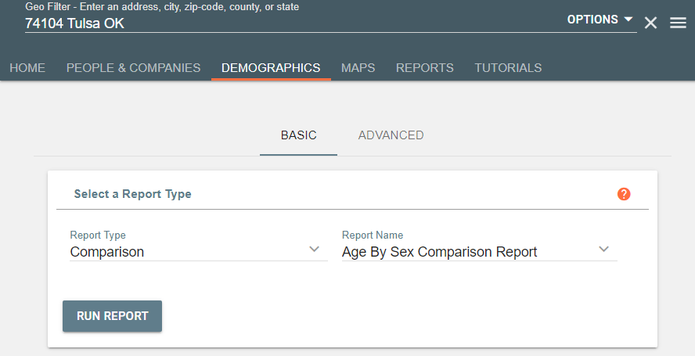
Select Demographics

Slide 9
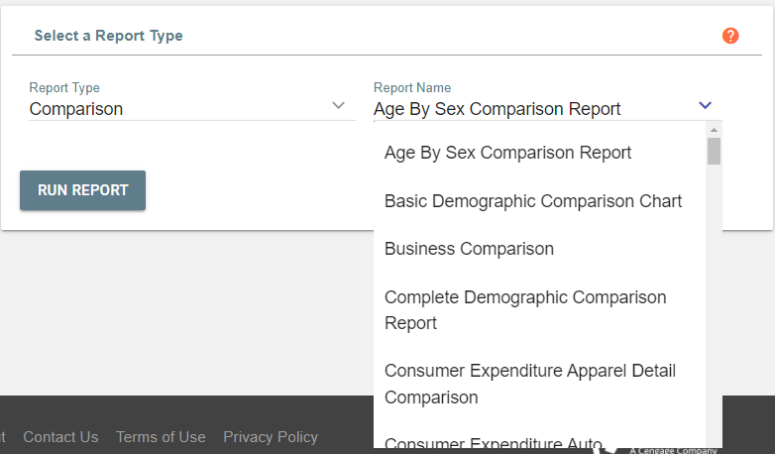
Select the Report You’d Like to Use

Slide 10
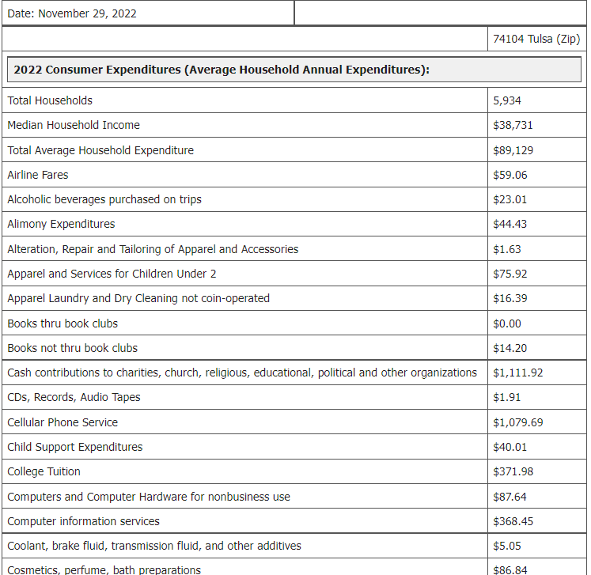
Run Report:

Slide 11
Let’s Practice!

Slide 13
Finding Effective Buying Income and Projections

Slide 14
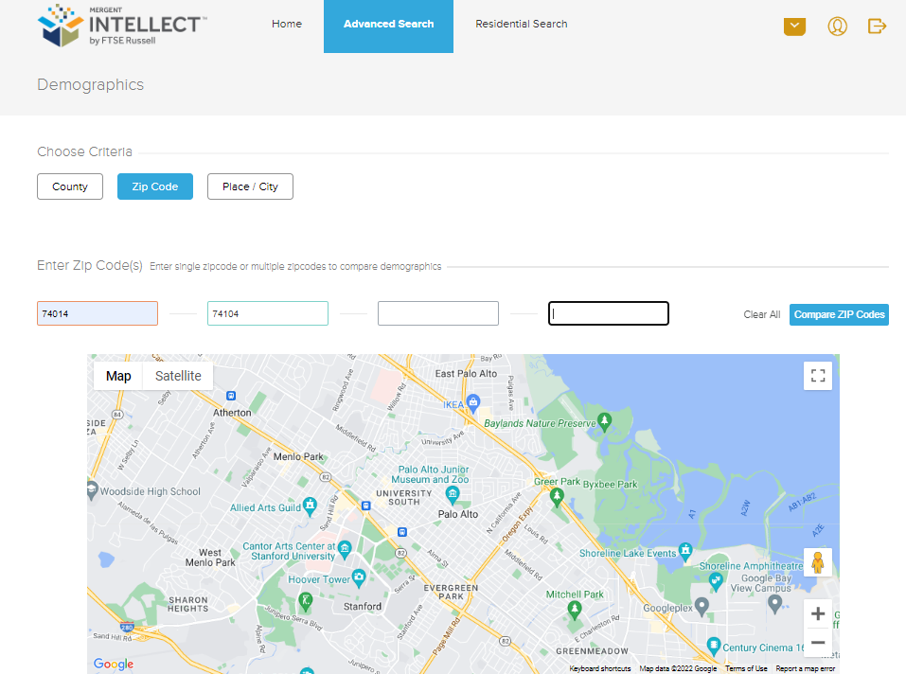
Set Zip Codes:

Slide 15
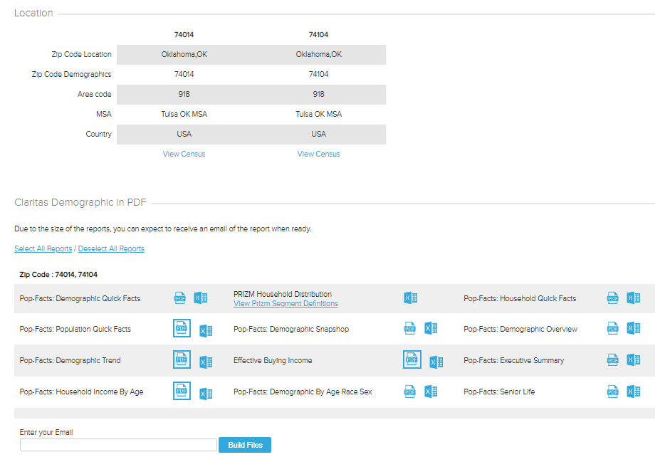
Select PDFs:

Slide 16
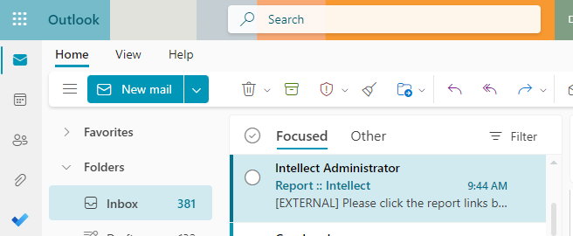
Check Your E-mail:

Slide 17
View Report:

Slide 18
What is the overall operation cost for your industry?

Slide 19
Cost-Based Pricing

Slide 21
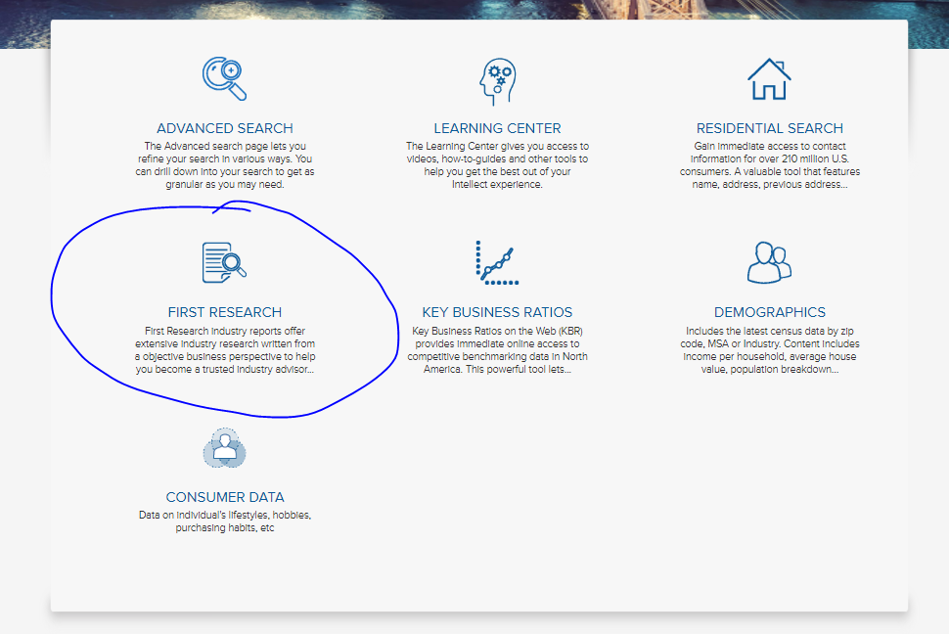

Slide 22
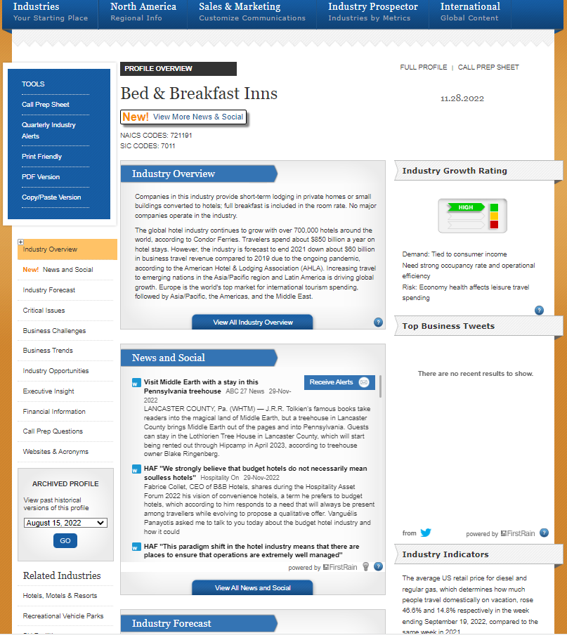
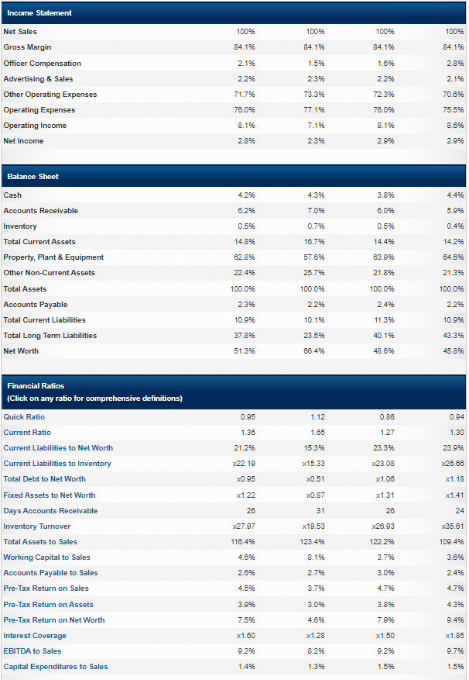

Slide 24
What You’ll Find Through a Bizminer Report

Slide 25
Questions?

Slide 26
AskUs
918-549-7323
askus@tulsalibrary.org

Slide 27
Aubrey.naiman@tulsalibrary.org
918-549-7429
AskUs
918-549-7323

Slide 32
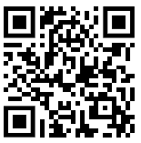
Survey

