Slide 2
COMMUNICATION SKILLS FOR MANAGERS
Nicole Morgan, APR

Slide 3
ABOUT RESOLUTE
RESOLUTE IS AN INTEGRATED AGENCY DELIVERING
BOLD AND PURPOSEFUL BRANDING AND MARKETING STRATEGIES.
We invest in our clients, create brand partnerships and develop targeted strategies.
Your Challenges. Your Goals. Together, we can be Resolute in achieving success.
CERTIFICATIONS
2023

Slide 4
What You’ll Learn
Why communication as a manager and a leader is important
How communication impacts your team
Forms of bad communication and what not to do
Understanding the communication styles of your team
How to build trust through clear communication

Slide 5
Outcomes
You will be more confident and thoughtful about your communication style.
Your employees will feel inspired and open in their communication with you.
You will continue to grow as a leader with this powerful tool of communication.

Slide 6
CONCISE COMMUNICATION IN A MANAGEMENT ROLE

Slide 7
Concise Communication in a Management Role
Speaking concisely means getting your message across as directly and efficiently as possible
According to a study from the Microsoft Corporation, you only have about 8 seconds to grab someone’s attention. After that, they rapidly start to lose their concentration.

Slide 8
Benefits of Concise Communication
Less room for guessing
Less confusion
Less flowery language
Clear direction on what you’re trying to communicate

Slide 9
How to Communicate Concisely
Use ”flagging phrases” to call out important points
The important thing to remember is…
There are 3 key things I want you to remember (people love numbers)
The one thing I want you to walk away knowing is…

Slide 10
How to Communicate Concisely
Bring and refer to your notes to make sure you don’t miss any important points.
Practice what you’re going to say before you say it.
Make sure you sound like yourself. Authenticity is important!
Don’t feel you need to fill the silence by saying more than is needed. This is an opportunity to get feedback.

Slide 11
How to Communicate Concisely
Confirm they understood what you said. Example questions:
Is there anything I’m missing?
Is there anything that’s not clear yet?
Do you have any questions?
Is there anything that concerns you here?
What other ideas do you have?

Slide 12
LEGAL CONSIDERATIONS
IN EMAIL COMMUNICATIONS

Slide 13
Things to Never Include in an Email
Mean, rude or hateful statements
Gossip
Inappropriate or harassing messages
Statements that conflict with your HR policies
Criticisms that could be seen as “talking down” to someone or lacking patience
Verbiage that’s condescending
Jokes that could be taken out of context

Slide 14
Tone and Email
Because you don’t hear the voice of the other person, beware that tone can get lost in email.
Context is the background information and other factors that could be contributing to why someone responds in a certain way. In email, we lose a certain amount of context because we aren’t actively having a conversation with the other person.

Slide 15
Managing Heated Email Communication
Don’t respond when you’re emotional. Take time to calm down before you respond.
Don’t type your initial response in the email. Write it out in a separate document so you have time to review and edit before you send.
Don’t type in all caps- it looks like you’re yelling.
Use exclamation points sparingly and only for happy statements.
Refrain from emailing during off hours.

Slide 16
Benefits of Email
It creates a paper trail, especially if you are trying to document employee performance.
It gives the employee something they can go back and reference to make sure they have the right information.

Slide 17
Writing an Impactful Email
Limit the subject line to 2-3 words
Try to keep the email under 200 words
Use bullet points and headings to break up the information for longer emails
Let the recipient know where they can go to ask questions
Re-read the email as if you are the employee before you hit send

Slide 18
INTERPERSONAL
SKILLS
FOR MANAGERS

Slide 19
How to be an Active Listener
Put away your phone and other electronic devices.
Maintain eye contact as much as possible.
Don’t just respond. Try to understand why the other person feels the way they do.
Stay calm, even when things get heated.
Repeat back what you’ve heard to ensure it’s accurate.

Slide 20
Having Empathy as a Manager
Empathy means you do more than just listen to others. You take time to understand how they feel, why they feel it and what they need in a situation.
The Center for Creative Leadership makes an important distinction between sympathy and empathy. Sympathy is feeling sorry for someone and having pity on them. But empathy is about understanding what it’s like to be in someone else’s shoes.

Slide 21
Tips for Practicing Empathy
Remember your employees are human. Outside stressors can impact moods and performance.
Practice openness and understanding.
Know your company’s resources, such as retirement, healthcare and life skills training, and remind employees how to access them.

Slide 22
Reading Between the Lines
Non-Verbal Communication is the act of observing the other person’s body language to better understand their emotions and mood around a situation.

Slide 23
What to Look for in Non-Verbal Communication
Signs of frustration
Abrupt movements or changes in behavior
Getting red in the face
Crossing their arms
Holding back on their words
Signs of emotion
Suddenly becoming disinterested in work
Teary eyes
Avoiding coworkers
Hunched shoulders or an overall appearance of being deflated

Slide 24
How to Handle Concerns
Pay attention for drastic changes in mood.
Allow the employee to disclose the issue rather than accusing them.
Have a one-on-one conversation
”I just wanted to check in and see how you’re doing. Is everything ok?”
Know that employees may not feel comfortable talking to you if trust hasn’t been built. It may take a few tries.

Slide 25
The Importance of Mentorship
Employees are more likely to stay in a job if they feel like they’re being invested in and that there’s opportunity for them to move up in the organization.
When you are a mentor, you are coaching them in their growth.

Slide 26
Examples of Mentorship
Helping an employee walk through how they could handle a conflict differently next time.
Brainstorming how another employee might have felt in a negative situation or where they may have been coming from.
Helping an employee come up with a plan for how they can better manage their emotions so they don’t get so frustrated.
Giving an employee ideas for how they can problem-solve a difficult situation.

Slide 27
THE IMPACT OF COMMUNICATION
SKILLS ON LEADERSHIP

Slide 28
Communication Impacts Leadership
The way you communicate impacts how others see you as a leader.
Bad forms of communication in leadership:
Speaking harshly
Talking down to employees
Coming across as blunt or is disinterested in your employees
A leader who focuses on strong communication skills will guide, inspire and motivate their employees.
It all comes down to building trust.

Slide 29
The Importance of Credibility
When a leader is credible, it means that they have accurate information and have earned their authority.
Don’t share information you’re unsure of.
Don’t talk about things in which you aren’t the authority.
Don’t gossip and spread rumors.
Communicate openly and honestly.

Slide 30
Strong Communication for the Team
Strong leaders know how to make people feel heard and can help people find common ground in a conflict.
Strong leaders help avoid misunderstandings and are always looking for potential communications issues within their team before they become a larger problem.
By setting the example of what a strong communicator looks like, you are teaching your team an important lesson. You’re essentially saying “this is how we communicate within our team, and anything outside of that will not be permitted.

Slide 31
Adapting Communication Styles
Different employees, generations and backgrounds require different communication styles.
Pay attention to what engages each employee and adapt accordingly.
Changing up how you communicate builds a more effective team that feels engaged.
Leaders who focus on this style of communication tend to have higher levels of employee engagement, satisfaction, and overall team performance. When everyone is rowing in the same direction, it’s much easier to encourage your employees and keep morale high.

Slide 32
Communication Styles of Effective Managers
The Listener
Gives employees the space to provide feedback.
Ensures there isn’t any confusion and gives you a chance to clear up any misunderstandings before the team jumps into action.
The Director
Is clear in what needs to be done and providing all the necessary information.
The Collaborator
Sees the strengths that each person is bringing and motivates them to work together to get the job done.
The Inspirer
Creates a positive work environment and help their teams see the big picture.

Slide 33
BUILDING TRUST
THROUGH COMMUNICATION

Slide 34
The Role of Trust in Leadership
As leaders, we have a responsibility to our teams.
Leaders who lack trust may see the following within their teams.
Fear
Frustration
Lack of confidence in the organization
Rumors spreading among employees
Frequent turnover

Slide 35
Signs That You Have Employees’ Trust
They have a clear picture of where the organization is going and what their career path looks like.
They are motivated to get work done.
Your production is increasing.
Everyone is communicating well, even when you’re having difficult conversations.
Employees are staying- and growing- with the company.

Slide 36
Keeping Trust Takes Work
Trust takes time to build, and it can quickly be broken.
It requires both the manager and the employee to work on keeping trust.
As the leader, it’s your responsibility to make sure this stays a priority.

Slide 37
Ways to Build and Keep Trust
Keep the lines of communication open.
Hold regularly scheduled team meetings
Find one-on-one time with employees
Be consistent
Stay calm and keep your own emotions in check so employees know they can count on you
Look for teaching opportunities
Tell employees it’s OK to ask questions or to admit if they need help
Show employees that you have their growth in mind

Slide 38
Ways to Build and Keep Trust
Don’t lie
Know what you can and can’t say legally
Only speak when you have the right information
Be vulnerable
Show your employees that you are human
Give compliments
It shows employees you’re paying attention to their work and that it matters

Slide 39
Things That Can Impact Trust
A big change in the company, such as new leadership, a new process or new equipment
A new hire
An employee leaving
A person issue affecting a team member’s mood
Lack of trust affects team performance, motivation and work quality.

Slide 40
THANK YOU!
NICOLE@RESOLUTEPR.COM
WWW.RESOLUTEPR.COM

Slide 42
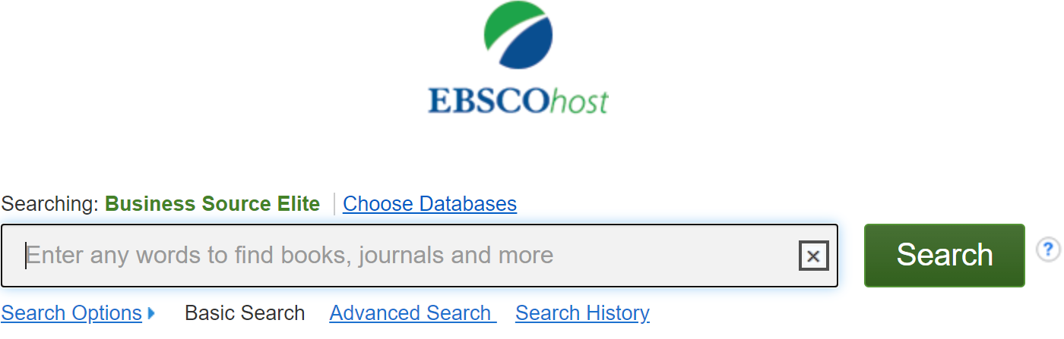
Business Source Elite

Slide 43
Questions?

Slide 44
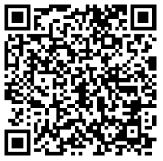
Survey

Slide 45
AskUs
918-549-7323
askus@tulsalibrary.org

Slide 46
Aubrey.naiman@tulsalibrary.org
918-549-7429
AskUs
918-549-7323

