Slide 2
efficiency Vs. effectiveness

Slide 3
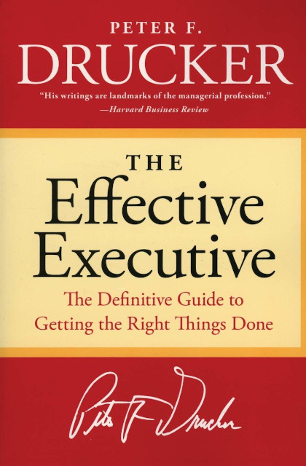
How to become effective
First published in 1967, Peter F. Drucker’s book argues that virtually all knowledge workers (not just executives) must be effective to perform their jobs well.
This Photo by Unknown Author is licensed under CC BY-NC

Slide 4
What is effectiveness?
Drucker defines efficiency is doing things right, and effectiveness is getting the right things done. Effectiveness is a self-discipline requiring specific habits of mind that must be learned. It allows us to convert our abilities (such as creativity, intelligence, and knowledge) into meaningful results.

Slide 5
Effectiveness in Practice
Know where your time goes
Focus on outward contribution
Build on strength
Put first things first
Make effective decisions

Slide 6
How is my time spent?
1. Learn where your time goes by recording how you spend your time each day for a specified period. Even if you take no further steps towards becoming effective, this alone should motivate you to improve.
2. Identify time wasters and prune them. What are you doing that could be done by someone else? Or, what are you doing that need not be done at all?

Slide 7
Time Management for the real world
Oliver Burkeman’s book, Four Thousand Weeks: Time Management for Mortals, makes a sobering yet liberating case for making wise decisions on how to spend your time.

Slide 8
What can I contribute?
Drucker challenges his readers to sincerely ask themselves, “What contribution can I make?” (In other words, why are you on your organization’s payroll?)
When attempting to answer this question, your attention should be directed outward, to how you can best serve your customers.

Slide 9
What are my/his/her/their strengths?
Drucker argues that good executives focus on leveraging strength over avoiding or correcting weakness.
If you have staff, hire someone whose strengths match the needs of the position. Don’t waste time trying to avoid weaknesses that are ultimately irrelevant.
When it comes to yourself, focus on developing and leveraging your strengths over improving your weaknesses.

Slide 10
Know your own strength
Drucker’s book, Managing Oneself, offers sound advice for learning more about yourself and leveraging your individual strengths.
This Photo by Unknown Author is licensed under CC BY-NC-ND

Slide 11
What is the one most important thing?
Drucker encourages his readers to focus on one task at a time. Our culture encourages business and multitasking, but most people can’t do more than one thing at a time well.
Choose the most important task, and devote all your energy to the task until it is complete.
(Burkeman offers the same advice in Four Thousand Weeks.)

Slide 12
How do I decide?
Classify the problem: is it generic or exceptional?
Define the problem: what is key?
Define the boundary conditions: what is the answer to the problem?
Decide what is right rather than what is acceptable.
Build an action plan into your decision.
Test the validity of your decision.

Slide 13
Key takeaways
Accepting our limitations and making wise decisions about how we spend our time can give us the space we need to accomplish the most important things, but not all the important things. (And that’s OK!)
Getting clear about what you should contribute will help you prioritize.
It’s far better to spend your energy to leveraging strengths– both other people’s and your own– than to worry about weaknesses.
If you want to be productive, choose the first most important task, and focus only on that task until its complete.
Good decision making is critical to being effective. Make only those decisions which need to be made so you can spend the time and resources necessary to make sound ones.

Slide 14
Thank you
Allison Embry-Saenz
Research Services Manager
allison.embry-saenz@tulsalibrary.org

Slide 16
Activity
I’m going to give you a number and give you a household item based on that number
You get five minutes to think of alternative uses to your item

Slide 17
Five minutes on the clock

Slide 18
Activity
Pair up with the other people with your number and discuss your answers

Slide 19
Activity
Work together and discuss how you would make this item better

Slide 20
Five minutes on the clock

Slide 21
Activity
How did you decide where to start?
What did you do to order your thoughts?
How did working in a team different from working on your own?
Notes:
How did you make sure to best use your five minutes?

Slide 22
Questions?

Slide 23
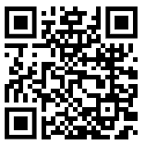
Survey.

Slide 24
AskUs
918-549-7323
askus@tulsalibrary.org

Slide 25
Heather.Lozano@tulsalibrary.org
918-549-7429
wizard@tulsalibrary.org
918-549-7431
AskUs
918-549-7323

Slide 26
Upcoming Classes and Events
7/12 Books on Tap Oklahoma Beer: A Handcrafted History meet up
@ NEFF 6-8 7/27 Grow Academy Forms and Permits from 10-12
8/7 Practice Pitch Presentations Event 8/24 Grow Academy Finances and Business from 10-12
9/28 Graduation!!
Notes:
How did you make sure to best use your five minutes?

