Slide 3
Break Even Analysis

Slide 4
Financial Projections

Slide 5
Questions?

Slide 6
AskUs
918-549-7323
askus@tulsalibrary.org

Slide 7
Aubrey.Naiman@tulsalibrary.org
918-549-7429
AskUs
918-549-7323

Slide 8
Graduation
September 28 from 10-12
@ 36°N Basecamp

Slide 9
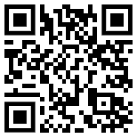
Survey

